Slide 1

Ward Sabha|Kavalbyrasandra # 32
19 August 2017

Slide 2

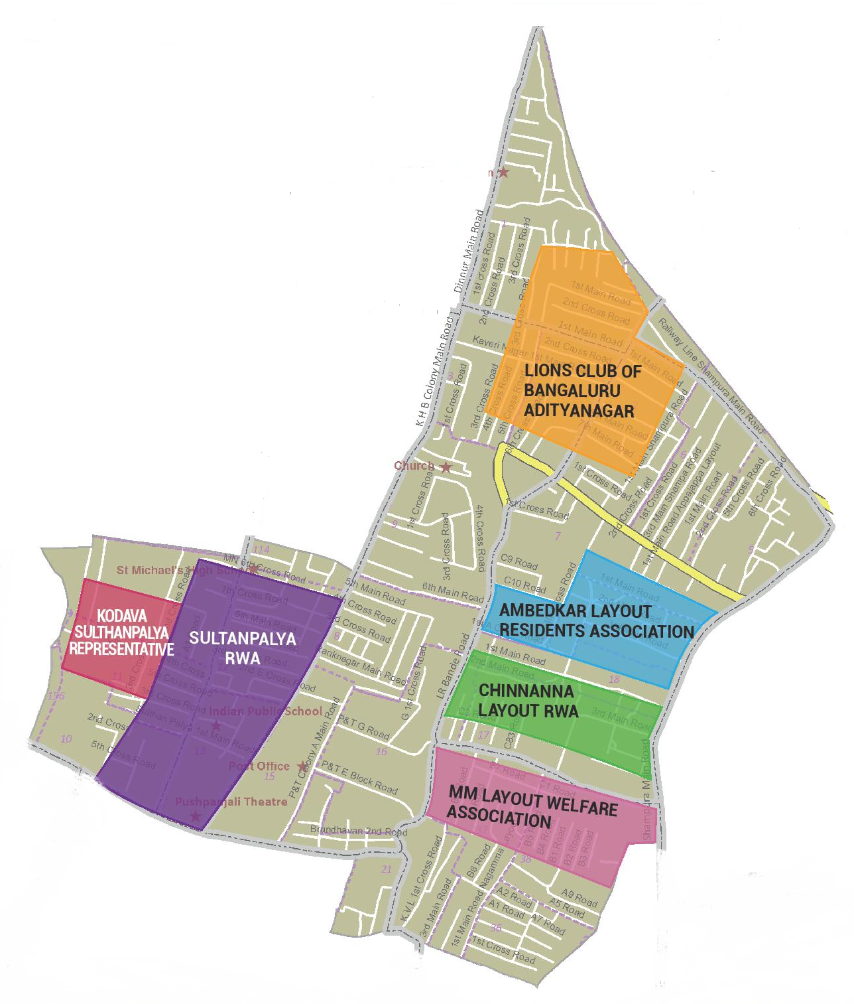
RWAs covered today
* Ambedkar Layout RWA
* Chikkanna Layout RWA
* Kodava Sultan Palya RWA
* Lions Club Bengaluru Aditya Nagara
* MM Layout RWA
* Sultan Palya RWA

Slide 3
Civic Directory
Agency | Department | Name | Designation | Phone
BBMP | BBMP | Nethra Narayan | Councillor | 9844046268
BBMP | Engineering | T Krishana Murthy | AE | 9480684027
BBMP | SWM | Raja | AEE | 9663674226
BBMP | Horticulture | Manjula | HI | 9845058004
BBMP | SWD | Basavarajappa | AEE | 9448154988
BESCOM | Engineering | Jagadish | AEE | 9449844645
BESCOM | Engineering | Gautham | AE | 9449864899
BWSSB | Engineering | Chenabasavaiha | AEE | 9845444025
BWSSB | Engineering | Husain Basha | AE | 9845444023
BCP | Crime & Safety | Munikrishna | PI | 9480801220
BCP | Crime & Safety | Noorajan Sabar | SI | 9945795096
BTP | Traffic | Rajappa | SI | 9741009781

Slide 4
MyCityMyBudget Citizen Inputs
Status Update

Slide 5
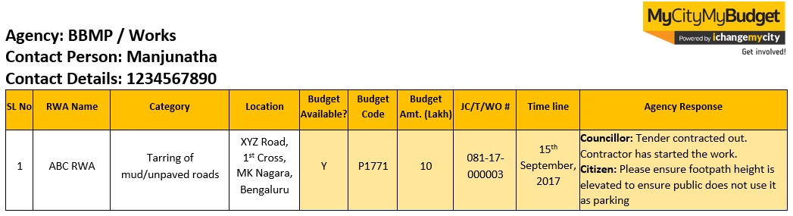
MyCityMyBudget | Guidelines for referring Minutes of Ward Sabha Meeting
The following slides provide a quick snapshot of each of the issues mentioned by RWAs. All agency responses specific to each input are recorded in the slides as well.
All the citizen input slides follow the below table layout:
Agency name and concerned officer details
Serial Number recorded here corresponds to the progress report provided during the ward sabha
This columns record budget availability, budget code, budget amount, job code details are provided by the agency, then data is recorded in these columns. JC- Jobcode, T- Tender, WO- Work Order. and time line.
If the agency provides specific timelines, the information is recorded here
Additional issue-specific comments that were discussed between agency and RWAs are recorded here
These 3 columns record RWA Name, Budget Input (Category) and Location.

Slide 6
Agency : BBMP - Works
Contact Person : T Krishna Murthy-AE
Contact Details : 9480684027
SL No | RWA Name | Category | Location | Budget Available? | Budget Code | Budget Amt. (Lakh) | JC/T/WO # | Time line | Agency Response
1 | Ambedkar Layout Residents Association | Construction of flyover/underpass | Lr Bande Rd,Railway Level Crossing, Kaval Bairasandra, Bengaluru, Karnataka, India | N | - | - | - | - | T Krishna Murthy: this is under Major Roads, we have already submitted the proposal for 18 Cr and are awaiting approval.
2 | Ambedkar Layout Residents Association | Construction of flyover/underpass | Shampura Main Rd,Railway Level Crossing, Underpass, Kaval Bairasandra, Bengaluru, Karnataka 560032, India | N | - | - | - | - | T Krishna Murthy: this is under Major Roads, we have already submitted the proposal for 18 Cr and are awaiting approval.
3 | Ambedkar Layout Residents Association | Construction of Public Toilets | Lr Bande Rd, Kaval Bairasandra, Bengaluru, Karnataka, India | Y | Swachha Bharat Grant | - | - | - | T Krishna Murthy: Swachha Bharat Grants sanctioned for this work. But we don’t have place to build. We welcome Citizen suggestions on possible locations.

Slide 7
Agency : BBMP - Works
Contact Person : T Krishna Murthy-AE
Contact Details : 9480684027
SL No | RWA Name | Category | Location | Budget Available? | Budget Code | Budget Amt. (Lakh) | JC/T/WO # | Time line | Agency Response
4 | Ambedkar Layout Residents Association | Construction of Public Toilets | Shampura main road Kaval Bairasandra, Bengaluru, Karnataka 560032, India | Y | Swachha Bharat Grant | - | - | - | T Krishna Murthy: Swachha Bharat Grants sanctioned for this work. But we don’t have place to build. We welcome Citizen suggestions on possible locations
5 | Ambedkar Layout Residents Association | Desilting of existing road-side drains | Shampura main road Kaval Bairasandra, Bengaluru, Karnataka 560032, India | - | - | - | - | - | T Krishna Murthy: Shampura main road one side de-silting done. The other side does not come in our ward. We will convey it to the other ward AE to do de-silting .
6 | Ambedkar Layout Residents Association | Construction of Community Hall | LR Bande rd next to Ragahvendra matta | Y | - | 300 | - | - | Councillor: Letter given to BDA. Need to find location . MLA mentioned 3 core budget available under MLA Grant.

Slide 8
Agency : BBMP - Works
Contact Person : T Krishna Murthy-AE
Contact Details : 9480684027
SL No | RWA Name | Category | Location | Budget Available? | Budget Code | Budget Amt. (Lakh) | JC/T/WO # | Time line | Agency Response
7 | Chinnanna Layout RWA | Tarring of pothole-ridden roads | 1st main,2main,3rd main & all cross roads of Chinnanna layout | Y | Nagarothana | 150 | - | October | T Krishna Murthy: Tender in process.
8 | Chinnanna Layout RWA | Installation of Surveillance Cameras | 1st main,2main,3rd main & near Chinnanna RWA office opposite Chinnanna layout | Y | POW 2016-17 | 10 | WO | October | T Krishna Murthy: Tender in process. RWA members can provide suggestions for CCTV camera locations.
9 | Sulthanpalya RWA | Tarring of pothole-ridden roads | Sulthanpalya Ganesha block hanumanthappa layout Kavalbyrasandra | - | - | - | - | 7th September2017 | T Krishna Murthy: Ganesha block work will start 15 to 20 days.

Slide 9
Agency : BBMP - Works
Contact Person : T Krishna Murthy-AE
Contact Details : 9480684027
SL No | RWA Name | Category | Location | Budget Available? | Budget Code | Budget Amt. (Lakh) | JC/T/WO # | Time line | Agency Response
10 | Kodava Sulthanpalya Representative | Installation of Surveillance Cameras | 4th cross Ganesha block and 5th cross Atmananda colony | Y | POW 2016-17 | 10 | WO | October | T Krishna Murthy: Tender in process. RWA members can provide suggestions for CCTV camera locations.
11 | Kodava Sulthanpalya Representative | Build dry waste collection centre | Ganesha block & Atmananda colony | - | - | - | - | - | T Krishna Murthy: Already we have one dry waste collection centre. We can have only one per Ward. This is currently not area wise .

Slide 10
Agency : BBMP - Works
Contact Person : T Krishna Murthy-AE
Contact Details : 9480684027
SL No | RWA Name | Category | Location | Budget Available? | Budget Code | Budget Amt. (Lakh) | JC/T/WO # | Time line | Agency Response
12 | Lions Club of Bengaluru Adityanagar | Repair of existing footpath | K.B Sandra, LR Bande main road & Shampura main road | Y | POW 2017-18 | 200 | - | 15-December-2017 | T Krishna Murthy: Work will start December.
13 | Lions Club of Bengaluru Adityanagar | Tarring of mud/unpaved roads | Railway parallel road, Shampura, BMK | Y | Nagarothana | 150 | - | October | T Krishna Murthy: Tender in process.
14 | Lions Club of Bengaluru Adityanagar | Construction of Public Toilets | Pushpanjali Bus stop & Lal Bhadur Shastri First grade college | - | - | - | - | - | T Krishna Murthy: We were scheduled to construct in the land that has currently gone for the Indira canteen. An alternate location needs to be found. Citizens suggested E Toilet as an option.

Slide 11
Agency : BBMP – Works
Contact Person : T Krishna Murthy-AE
Contact Details : 9480684027
SL No | RWA Name | Category | Location | Budget Available? | Budget Code | Budget Amt. (Lakh) | JC/T/WO # | Time line | Agency Response
15 | Lions Club of Bengaluru Adityanagar | Installation of Surveillance Cameras | LR Bande, BBMP Ward Office & other junctions | Y | POW 2016-17 | 10 | WO | - | T Krishna Murthy: Tender in process. RWA members can provide suggestions for CCTV camera locations.
16 | MM Layout Welfare Association | Tarring of pothole-ridden roads | 3rd main road MM layout | - | - | - | - | - | T Krishna Murthy: MM layout 3rd main Road 90% work done. Additional slabs are not available. Will be procured at the earliest and this work closed
17 | MM Layout Welfare Association | Installation of Surveillance Cameras | 3rd main road & All cross roads of MM layout | Y | POW 2016-17 | 10 | WO | - | T Krishna Murthy: Tender in process. RWA members can provide suggestions for CCTV camera locations.

Slide 12
Agency : BBMP - Forest
Contact Person :
Contact Details :
SL No | RWA Name | Category | Location | Budget Available? | Budget Code | Budget Amt. (Lakh) | JC/T/WO # | Time line | Agency Response
18 | MM Layout Welfare Association | Planting New Trees | 3rd main road MM layout | - | - | - | - | - | The Agency representative did not attend the meeting.
19 | Chinnanna Layout RWA | Planting New Trees | 1st main,2main,3rd main Chinnanna layout | - | - | - | - | - | The Agency representative did not attend the meeting.
20 | Kodava Sulthanpalya Representative | Planting New Trees | Ganesha block & Atmananda colony | - | - | - | - | - | The Agency representative did not attend the meeting.

Slide 13
Agency : BBMP - Health
Contact Person : Raja (Health inspector)
Contact Details : 9663674226
SL No | RWA Name | Category | Location | Budget Available? | Budget Code | Budget Amt. (Lakh) | JC/T/WO # | Time line | Agency Response
21 | Chinnanna Layout RWA | Fogging and Pest Control | Full Chinnanna layout | - | - | - | - | - | The Agency representative did not attend the meeting.
22 | Lions Club of Bengaluru Adityanagar | Fogging and Pest Control | Salem Railway parallel road, parks & P&T Qtrs. & Grave yards | - | - | - | - | - | The Agency representative did not attend the meeting.
23 | MM Layout Welfare Association | Fogging and Pest Control | Entire MM Layout | - | - | - | - | - | The Agency representative did not attend the meeting.

Slide 14
Agency : BBMP- Strom Water Drain
Contact Person : Basavarajappa-AEE
Contact Details : 9448154988
SL No | RWA Name | Category | Location | Budget Available? | Budget Code | Budget Amt. (Lakh) | JC/T/WO # | Time line | Agency Response
24 | Chinnanna Layout RWA | Repair of Strom Water Drains | 1st Main Rd Chinnanna layout | - | - | - | - | - | The Agency representative did not attend the meeting.
25 | Sulthanpalya RWA | Repair of Strom Water Drains | Sulthanpalya Ganesha block hanumanthappa layout Kavalbyrasandra | - | - | - | - | - | The Agency representative did not attend the meeting.
26 | MM Layout Welfare Association | Repair of Strom Water Drains | 3rd main road MM layout | - | - | - | - | - | The Agency representative did not attend the meeting.
27 | Lions Club of Bengaluru Adityanagar | Repair of Strom Water Drains | P&T Quaters, Kavalbyrasandra main road, LR Bande main road & Railway line area | - | - | - | - | - | The Agency representative did not attend the meeting.

Slide 15
Agency : BESCOM
Contact Person : Gautham-AE
Contact Details : 9449864899
SL No | RWA Name | Category | Location | Budget Available? | Budget Code | Budget Amt. (Lakh) | JC/T/WO # | Time line | Agency Response
28 | Sulthanpalya RWA | Regular Supply of Electricity | Sulthanpalya Ganesha block hanumanthappa layout Kavalbyrasandra | - | - | - | - | 19-September-2017 | Gautham: In Emergency only we will cut power supply. The current requirement will be supplemented as we are exploring extra power from Hebbala power station. There is planned load shedding which will also impact supply.

Slide 16
Agency : BWSSB
Contact Person : Husain Basha-AE
Contact Details : 9845444023
SL No | RWA Name | Category | Location | Budget Available? | Budget Code | Budget Amt. (Lakh) | JC/T/WO # | Time line | Agency Response
29 | Sulthanpalya RWA | Maintenance of existing water pipeline | Sulthanpalya Ganesha block hanumanthappa layout kavalbyrasandra | - | - | - | - | 29-August-2017 | Husain Basha: All issues are noted down, we will attend the issues with in a 10 days.
30 | Kodava Sulthanpalya Representative | Provide Regular Water | All the cross roads of Atmananda colony | - | - | - | - | - | Husain Basha: Water pressure is low in this area, frequency of water supply will be increased to once in 2 days. Valve man is to sign in the register and community to confirm
31 | Kodava Sulthanpalya Representative | Maintenance of existing water pipeline | Atmananda colony | - | - | - | - | - | Husain Basha: Will check the issues on site.
32 | Sulthanpalya RWA | Maintenance and Repair of Sewage Lines | Sulthanpalya Ganesha block hanumanthappa layout Kavalbyrasandra | - | - | - | - | 29-August-2017 | Husain Basha: All issues are noted down. We will attend issues with in 10 days.

Slide 17
Agency : BMTC
Contact Person :
Contact Details :
SL No | RWA Name | Category | Location | Budget Available? | Budget Code | Budget Amt. (Lakh) | JC/T/WO # | Time line | Agency Response
33 | Ambedkar Layout Residents Association | New bus routes | Kavalbyrasandra | - | - | - | - | - | The Agency representative did not attend the meeting.

Slide 18
Ward Infrastructure

Slide 19
SCORE for Parks Playground and Public Toilet
The Parks, Playgrounds and Public Toilets 2016 survey was conducted on 1,311 parks & playgrounds and 473 public toilets that fall under BBMP’s purview across Bengaluru. As a part of the survey, the quality of infrastructure and facilities was measured through the use of simple Android Apps. The survey was conducted between October to December 2016.
The survey indicator-level information pertinent to your ward.
SL No | Park Name | Score
1 | Postal & telegram Badavane BSNL Office road Part-2 Sulthanpalya | 7
2 | K H B Quarters Park | 0
3 | Postal & telegram Badavane BSNL Office road Part -1 Sulthanpalya | 6
4 | BSNL offices Road Part 9(Foot ball Ground) Park | 1
5 | BSNL office part-1 Park | 3
6 | L R Bande, Shampura BBMP Park Part 1 | 7
7 | Near Ward 32 Office Kavalbyrasandra | 0
8 | Near Sulthanpalya Bus Stop, Lal Bahadur Shastri Park | 0
 | Average | 3
SL No | Playground Name | Score
1 | Sultan Palya Play Ground, Dinnuru Main Road | 4
SL No | Public Toilet | Score
1 | NA

Slide 20
Next Steps
Our recommendations:
  Next meeting will be schedule month of November
  Review status of works
  Give inputs into next year’s budgets
  Please register on Ichangemycity.com to track ward budgets and civic works

Slide 21
Janaagraha Directory
Manjunath C M
manjugowda@janaagraha.org
Justin Ralph
Justin.ralph@janaagraha.org
9902333155
Janaagraha Centre for Citizenship and Democracy
4th Floor, UNI Building, Thimmaiah Road, Vasanthnagar, Bangalore - 560052
Tel: +91-80-4079-0400 Fax: +91-80-4127-7104 Mob: +91-9902333155
Website: www.janaagraha.org

