Slide 1

Ward Sabha| Mangammana Palya # 190
19 August 2017

Slide 2

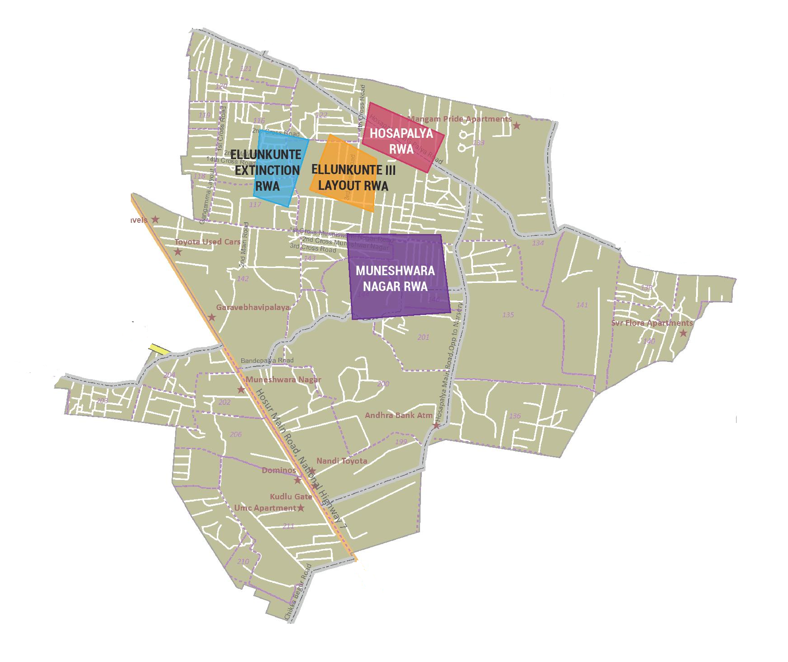
RWAs covered today
* Ellukunte ITI Layout RWA
* Muneshwara Nagara RWA
* Ellukunte Extinction RWA
* Hosapalya RWA

Slide 3
Civic Directory
Agency | Department | Name | Designation | Phone | Email
BBMP | BBMP | Shobha Jagadish Gowda | Councillor | 9448388585
BBMP | Engineering | Dr Muralidhar | AEE | 9580685199
BBMP | Engineering | Eranna | AE | 9535563588 | eng.heeranna@gmail.com
BBMP | Health | Raju | Health Inspector | 9611175391
BBMP | Health | Honnurbasha | JHI | 9945145661 | honnurbasha.oblp@gmail.com
BBMP | Horticulture | Shamanth Kumar | Superintendent | 9448649335
BWSSB | Engineering | Saibhanna | AE | 9845444039
BESCOM | Engineering | Vijaya Kumar | JE | 9449840469
BBMP | Electrical | Ramesh | AE | 9986835425
BCP | Police | Suresh P L | Head Constable | 8970286878
BBMP | Horticulture | Narayanapura | Supervisor | 9739063379

Slide 4
MyCityMyBudget Citizen Inputs
Status Update

Slide 5
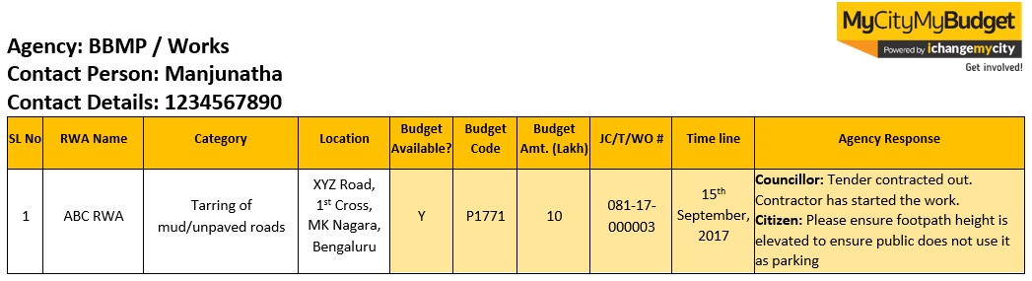
MyCityMyBudget | Guidelines for referring Minutes of Ward Sabha Meeting
The following slides provide a quick snapshot of each of the issues mentioned by RWAs. All agency responses specific to each input are recorded in the slides as well.
All the citizen input slides follow the below table layout:
Agency name and concerned officer details
Serial Number recorded here corresponds to the progress report provided during the ward sabha
This columns records budget availability, budget code, budget amount, job code details are provided by the agency, then data is recorded in these columns. JC- Jobcode, T- Tender, WO- Work Order. and time line.
If the agency provides specific timelines, the information is recorded here
Additional issue-specific comments that were discussed between agency and RWAs are recorded here
These 3 columns record RWA Name, Budget Input (Category) and Address.

Slide 6
Agency : BBMP / Works
Contact Person : Dr Muralidhar-AEE
Contact Details : 9580685199
SL No | RWA Name | Category | Location | Budget Available? | Budget Code | Budget Amt. (Lakh) | JC/T/WO # | Time line | Agency Response
1 | ITI Layout RWA | Installation of surveillance cameras | ITI Layout, Yellukunte | Y | - | 10 | - | - | Councillor: Entire ward 10 Lakhs sanctioned for this purpose, Installation will happen at 2 locations as suggested by the community for ITI Layout.
2 | ITI Layout RWA | Construction of New Bus Shelters | ITI Layout, Yellukunte | - | - | - | - | - | Dr Muralidhar: through the PPP 200 locations identified to build new bus shelters. We also recommend RWA should submit a letter to the Councillor to request new bus shelter. Post submission, Councillor will follow up with BBMP Commissioner
3 | ITI Layout RWA | Construction of Public Toilets | ITI Layout, Yellukunte | - | - | - | - | - | Dr Muralidhar: We request the citizens to also identify available location so that this project can be taken up. Community has agreed to assist in identifying the location.

Slide 7
Agency : BBMP / Works
Contact Person : Dr Muralidhar-AEE
Contact Details : 9580685199
SL No | RWA Name | Category | Location | Budget Available? | Budget Code | Budget Amt. (Lakh) | JC/T/WO # | Time line | Agency Response
4 | ITI Layout RWA | Build dry waste collection centers | ITI Layout, Yellukunte | - | - | - | - | - | Councillor: In our ward we already have one DWCC we don’t have option to build one more.
5 | ITI Layout RWA | Construction of Educational Institutions & Libraries | ITI Layout, Yellukunte | - | - | - | - | - | Dr Muralidhar: Community should submit letter to Library Chairman to request library. Post submission, Councillor will follow up with Library Chairman.
6 | ITI Layout RWA | Installation of Street Name boards | ITI Layout, Yellukunte | Y | POW 2017-18 | 10 | - | April, 2018 | Dr Muralidhar: Its included in 2017-18 POW. Work will commence from April 2018

Slide 8
Agency : BBMP / Works
Contact Person : Dr Muralidhar-AEE
Contact Details : 9580685199
SL No | RWA Name | Category | Location | Budget Available? | Budget Code | Budget Amt. (Lakh) | JC/T/WO # | Time line | Agency Response
7 | ITI Layout RWA | Installation of covering slabs for road-side drains | ITI Layout, Yellukunte | - | - | - | - | - | Dr Muralidhar: Budget is not available for particular work, will consider this has a emergency work and activity will be taken up.
8 | ITI Layout RWA | Desilting of existing road-side drains | ITI Layout, Yellukunte | Y | - | 1 | - | 20-Sept-2017 | Dr Muralidhar: Work will be complete with in a month
9 | ITI Layout RWA | Tarring of mud/unpaved roads | ITI Layout, Yellukunte | Y | Nagarothana Grants | - | - | 20-Sept-2017 | Dr Muralidhar: 9 Roads, Major road department under taken this work. Work will be complete with in a month

Slide 9
Agency : BBMP-Electrical
Contact Person : Ramesh-AE
Contact Details : 9986835425
SL No | RWA Name | Category | Location | Budget Available? | Budget Code | Budget Amt. (Lakh) | JC/T/WO # | Time line | Agency Response
10 | ITI Layout RWA | Installation of streetlights | ITI Layout, Yellukunte | Y | POW 2016-17 | 17 | - | 20-Sept-2017 | Councillor: Work will be complete with in a month

Slide 10
Agency : BBMP- Forest
Contact Person :
Contact Details :
SL No | RWA Name | Category | Location | Budget Available? | Budget Code | Budget Amt. (Lakh) | JC/T/WO # | Time line | Agency Response
11 | ITI Layout RWA | Planting New Trees | ITI Layout, Yellukunte | - | - | - | - | - | The Agency representative did not attend the meeting But Dr Muralidhar-AEE has suggested citizens to use BBMP green app. Once location is finalized by public, activity will be taken up. Community agree d to use green app to avail the saplings

Slide 11
Agency : BBMP-Health
Contact Person :Raju-SHI
Contact Details : 9611175391
SL No | RWA Name | Category | Location | Budget Available? | Budget Code | Budget Amt. (Lakh) | JC/T/WO # | Time line | Agency Response
12 | ITI Layout RWA | Fogging and Pest Control | ITI Layout, Yellukunte | - | - | - | - | 22-Aug-2017 | Raju: With in a 1 or 2 days activity will be taken up.

Slide 12
Agency : BBMP- Project
Contact Person : Ashok Kumar-AEE
Contact Details :
SL No | RWA Name | Category | Location | Budget Available? | Budget Code | Budget Amt. (Lakh) | JC/T/WO # | Time line | Agency Response
13 | ITI Layout RWA | Constructions of Parks | Kuvempu Park, ITI Layout, Yellukunte | - | - | - | - | - | Councillor : Constructions of Parks coming under project department please approach project department.

Slide 13
Agency : BESCOM
Contact Person : Vijaya Kumar-JE
Contact Details : 9449840469
SL No | RWA Name | Category | Location | Budget Available? | Budget Code | Budget Amt. (Lakh) | JC/T/WO # | Time line | Agency Response
14 | ITI Layout RWA | Relocation of old transformers/electric poles | 8th Main & 9th Cross, ITI Layout, Yellukunte | - | - | - | - | - | Vijaya Kumar: Alternate locations not available. Seek citizen support to identify locations to relocate the transformers.
15 | ITI Layout RWA | Repair of transformers/electric poles | ITI Layout, Yellukunte | - | - | - | - | - | Vijaya Kumar: Alternate locations not available. Seek citizen support to identify locations to relocate the transformers.

Slide 14
Agency : BMTC
Contact Person :
Contact Details :
SL No | RWA Name | Category | Location | Budget Available? | Budget Code | Budget Amt. (Lakh) | JC/T/WO # | Time line | Agency Response
16 | ITI Layout RWA | Increase frequency of buses | ITI Layout, Yellukunte | - | - | - | - | - | The Agency representative did not attend the meeting

Slide 15
Agency : BTP
Contact Person :
Contact Details :
SL No | RWA Name | Category | Location | Budget Available? | Budget Code | Budget Amt. (Lakh) | JC/T/WO # | Time line | Agency Response
17 | ITI Layout RWA | Installation of traffic lights | 4th Cross, 10th Main, ITI Layout, Yellukunte | - | - | - | - | - | The Agency representative did not attend the meeting

Slide 16
Agency : BBMP / Works / Electrical
Contact Person : Dr Muralidhar-AEE / Ramesh-AE
Contact Details : 9580685199 / 9986835425
SL No | RWA Name | Category | Location | Budget Available? | Budget Code | Budget Amt. (Lakh) | JC/T/WO # | Time line | Agency Response
18 | Muneshwara Nagara RWA | Construction of road side drains | Muneshwara Nagara | - | - | - | - | - | Dr Muralidhar: RWA should submit letter to Ward Councillor to request road side drain design modification . Post submission, Councillor will follow up with BBMP Joint Commissioner
19 | Muneshwara Nagara RWA | Installation of street light | Muneshwara circle | - | - | - | - | - | Councillor: We will fix LED lights
20 | Muneshwara Nagara RWA | Repair of street light | Muneshwara Nagara | - | - | - | - | - | Councillor: We have 300 lights once specific streetlight locations are provided by citizens, this activity will be taken up.

Slide 17
Agency : BBMP /Works/ Health Inspector
Contact Person :Dr Muralidhar-AEE /Raju-SHI
Contact Details :9580685199 / 9611175391
SL No | RWA Name | Category | Location | Budget Available? | Budget Code | Budget Amt. (Lakh) | JC/T/WO # | Time line | Agency Response
21 | Muneshwara Nagara RWA | Air Pollution | Muneshwara Nagara | - | - | - | - | - | Dr Muralidhar: Post spot inspection by AEE & Heath department, will give a notice to scrap yards.
22 | Muneshwara Nagara RWA | Garbage collection | Muneshwara Nagara | - | - | - | - | - | Raju : We have only one vehicle we can’t change our vehicle time as it impacts the schedule.

Slide 18
Agency : Health Inspector /BESCOM
Contact Person :Raju-SHI / Vijayakumar-JE
Contact Details :9611175391/9449840469
SL No | RWA Name | Category | Location | Budget Available? | Budget Code | Budget Amt. (Lakh) | JC/T/WO # | Time line | Agency Response
26 | Hosapalya RWA | Maintenance of crematoriums | Mangammanapalya | - | - | - | - | 20 Sept 2017 | Councillor: Work will be complete with in a month
27 | Hosapalya RWA | Fogging and Pest Control | Sun school back side Road and ITI layout surrounding | - | - | - | - | 22 Aug 2017 | Raju: With in a 2 days, activity will be taken up
28 | Hosapalya RWA | Regular supply of electricity | Kaveri layout and ITI layout | - | - | - | - | Aug 2018 | Vijaya Kumar: Power station construction under process in Bandepalya after that we will provide regular supply of electricity

Slide 19
Agency : Police
Contact Person :Suresh-HC
Contact Details : 9743095475
SL No | RWA Name | Category | Location | Budget Available? | Budget Code | Budget Amt. (Lakh) | JC/T/WO # | Time line | Agency Response
23 | Muneshwara Nagara RWA | Prevent anti social activities | Muneshwara Nagara | - | - | - | - | - | Suresh: Recommend citizens call 100 for emergency, we will attended with in 15 mints.
24 | Muneshwara Nagara RWA | Require night patrolling | Muneshwara Nagara | - | - | - | - | - | Suresh: Recommend citizens call 100 for emergency, we will attended with in 15 mints.
25 | Muneshwara Nagara RWA | Prevention of drug peddling | Muneshwara Nagara | - | - | - | - | - | Suresh: Recommend citizens call 100 for emergency, we will attended with in 15 mints. ll attended with in 15 mints.

Slide 20
Ward Infrastructure

Slide 21
SCORE for Parks Playground and Public Toilet
The Parks, Playgrounds and Public Toilets 2016 survey was conducted on 1,311 parks & playgrounds and 473 public toilets that fall under BBMP’s purview across Bengaluru. As a part of the survey, the quality of infrastructure and facilities was measured through the use of simple Android Apps. The survey was conducted between October to December 2016.
The survey indicator-level information pertinent to your ward.
SL No | Park Name | Score | Range
1 | NA
SL No | Playground Name | Score | Range
1 | NA
SL No | Public Toilet | Score | Range
1 | Bandepalya Near Govt School | 1 | 0-10
2 | Timber Road, Bandepalya | 0 | 0-10

Slide 22
Next Steps
Our recommendations:
  Meet after 3 months,
  Review status of works
  Give inputs into next year’s budgets
  Please register on Ichangemycity.com to track ward budgets and civic works

Slide 23
Janaagraha Directory
Manjunath C M
manjugowda@janaagraha.org
Yashawanth
yashawanth.rangegowda@janaagraha.org
9916481611
Janaagraha Centre for Citizenship and Democracy
4th Floor, UNI Building, Thimmaiah Road, Vasanthnagar, Bangalore - 560052
Tel: +91-80-4079-0400 Fax: +91-80-4127-7104 Mob: +9916481611
Website: www.janaagraha.org

