Slide 1

Ward Sabha|Ramamurthy Nagara # 26
07 October 2017

Slide 2

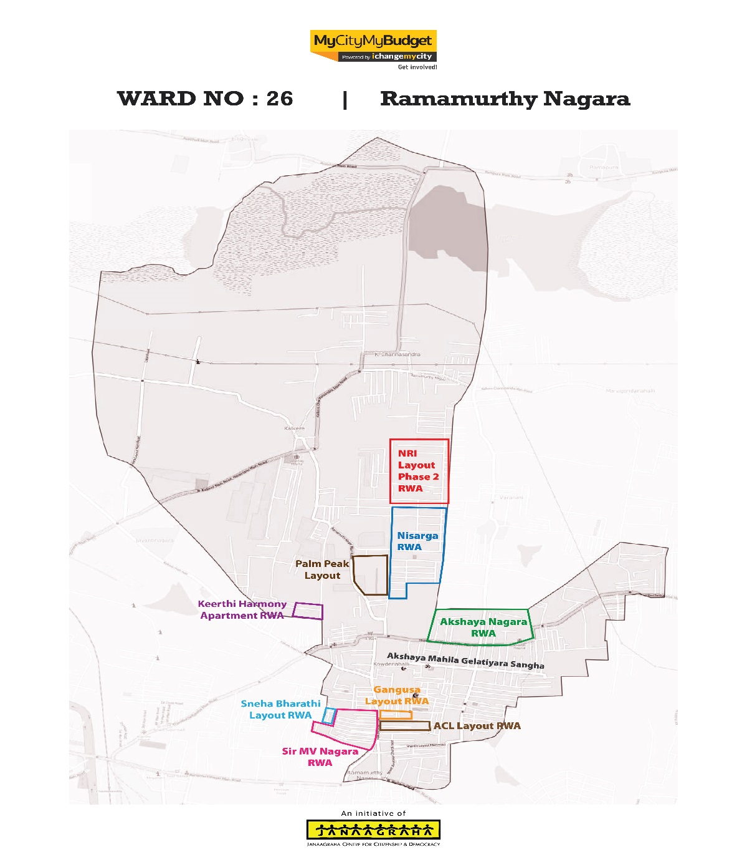
RWA Covered today
ACL Layout RWA Akshay Nagar RWA Gangusa Layout RWA Akshaya Mahila Gelathiyara Sangha NRI Layout Phase-2 Sir M V Nagar RWA Sneha Bharathi Layout RWA Keerthi Harmony Owners Welfare Association Nisarga Layout RWA

Slide 3
Civic Directory
Agency | Department | Name | Designation | Phone | Email
BBMP | BBMP | Padmavathi M | Councillor | 9611243911
BBMP | Engineering | Ramesh | Asst Engineer | 9739838297 | rameshthejasvi@gmail.com
BBMP | SWD | Panduranga | Asst Executive Engineer | 9448504504 | Nil
BBMP | Health | Vishwanath | Senior Health Inspector | 9916609413 | Nil
BBMP | Health | Manjunatha | Health Inspector | 9964547687
BBMP | Electric/Street Light | Gurappa Doddamani | Asst Executive Engineer | 9480685339 | bbmpkrpble@gmail.com
BBMP | Horticulture | Tyagaraju | Horticulture superintendent | 7259363162 | bbmpsfmdpura@gmail.com
BBMP | Major Roads | Satish | Asst Engineer | 9448426417 | Nil
BBMP | Lake | Shilpa | Asst Engineer | 9986553232 | cebbmplake@gmail.com
BWSSB | BWSSB | Lokesh | Asst Engineer | 9632422553 | aeee3@bwssb.org.com
BESCOM | BESCOM | V Manjula | Asst Engineer | 9449874210 | aeramamurthynagara_e7@bescom.co.in
BCP | Law & Order | Chandradara | Police Inspector | 9480801224 | rmnagarbcp@ksp.gmail.in
BTP | Traffic | ST Siddegwoda | Police Sub Inspector | 9686853456 | Nil

Slide 4
MyCityMyBudget Citizen Inputs Status Update

Slide 5
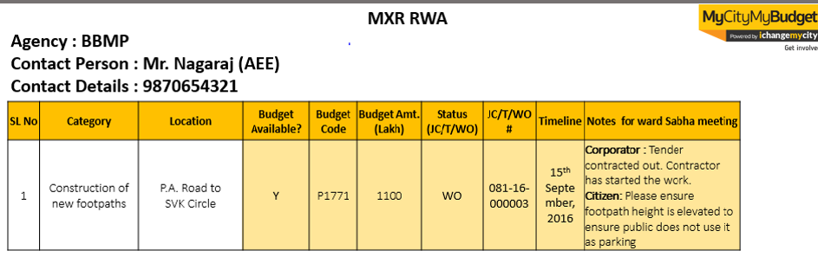
MyCityMyBudget | Guidelines for referring Minutes of Ward Sabha Meeting
The following slides provide a quick snapshot of each of the issues mentioned by RWAs. All agency responses specific to each input are recorded in the slides as well.
All the citizen input slides follow the below table layout:
Agency name and concerned officer details
Serial Number recorded here corresponds to the progress report provided during the ward sabha
If budget is required and specific work and job code details are provided by the agency then data is recorded in these columns. Status column indicates whether a a)tender has been issued(T), work order has been created(WO) or jobcode(JC) has been created for resolving this concern.
These 2 columns record the gist of the RWA concern. The budget/ grievance column records if money needs to be set aside for resolution or if it requires redressal
If the agency provides specific timelines, the information is recorded here
Additional issue-specific comments that were discussed between agency and RWAs are recorded here

Slide 6
Agency : BBMP - Works
Contact Person : Ramesh-AE
Contact Details : 9739838297
SL No | RWA Name | Category | Location | Budget Available? | Budget Code | Budget Amt. (Lakh) | JC/T/WO Status & Number | Time line | Agency Response
1 | ACL Layout RWA | Construction of road-side drains | A C L Layout | Y | Nagorathana Grants | 1750.00 | T | Projected Start Date-15th December | Ramesh: It's in tender process, work will be start in December
2 | ACL Layout RWA | Installation of covering slabs for road-side drains | A C L Layout | Y | Nagorathana Grants | 1750.00 | T | Projected Start Date-15th December | Ramesh: It's in tender process, work will be start in December
3 | ACL Layout RWA | Installation of surveillance cameras | A C L Layout | Y | 2017-18 Budget | 20.00 | _ | _ | Councillor: Budget of 20 lakhs available. once we get the approve from commissioner we will fix CCTV Cameras
4 | ACL Layout RWA | Lane Marking and Road Signage’s | A C L Layout | _ | _ | _ | _ | Projected Start Date-15th December | Ramesh: After the road asphalting, we will start lane marking work *Engineer has to give the budget details

Slide 7
Agency : BBMP - Works
Contact Person : Ramesh-AE
Contact Details : 9739838297
SL No | RWA Name | Category | Location | Budget Available? | Budget Code | Budget Amt. (Lakh) | JC/T/WO Status & Number | Time line | Agency Response
5 | ACL Layout RWA | Construction of Crematoriums, burial ground | Manjunath Layout | _ | _ | _ | _ | _ | Councillor: There is no Govt land in the ward to construct new burial ground. already we have one burial ground in kalkere main road people can use that.
6 | ACL Layout RWA | Construction of Markets | Manjunath Layout | _ | _ | _ | _ | _ | Councillor: Govt land not available in our ward to construct market.
7 | Akshay Nagar RWA | Construction of Health Care Buildings | Ramamurthy Nagar | _ | _ | _ | _ | _ | Ramesh: The health care building proposal already submitted to health department once its approved construction work will start in Horamavu ward and this is near to our ward also.

Slide 8
Agency : BBMP - Works
Contact Person : Ramesh-AE
Contact Details : 9739838297
SL No | RWA Name | Category | Location | Budget Available? | Budget Code | Budget Amt. (Lakh) | JC/T/WO Status & Number | Time line | Agency Response
8 | Akshay Nagar RWA | Construction of Markets | Shanthi Layout | _ | _ | _ | _ | _ | Councillor: Govt land not available in our ward to construct a market
9 | Akshay Nagar RWA | Construction of Public Toilets | Shanthi Layout, Akshay Nagar | _ | _ | _ | _ | _ | Councillor: In shanti layout and Akshay nagar we don’t have place to build public toilets
10 | Akshay Nagar RWA | Construction of road-side drains | Akshay Nagar, 1St Block, TC Palya main road, | Y | Nagorathana Grants | 450.00 | T | Projected Start Date-15th December | Ramesh: It's in tender process, work will be start in December
11 | Akshay Nagar RWA | Installation of Street Name boards | Akshay Nagar, 1St Block, TC Palya main road, | Y | 2017-18 POW | 30.00 | - | Projected Completion date -20th December | Ramesh: We are taken this work in 2017-18 budget and installation will happen in December

Slide 9
Agency : BBMP - Works
Contact Person : Ramesh-AE
Contact Details : 9739838297
SL No | RWA Name | Category | Location | Budget Available? | Budget Code | Budget Amt. (Lakh) | JC/T/WO Status & Number | Time line | Agency Response
12 | Akshay Nagar RWA | Installation of surveillance cameras | Akshay Nagar, 1St Block, TC Palya main road, | _ | _ | _ | _ | _ | Councillor: Budget of 20 lakhs available. once we get the approve from commissioner we will fix CCTV Cameras
13 | Akshay Nagar RWA | Tarring of pothole-ridden roads | Akshay Nagar,1St Block, upto 12th cross, TC Palya main road, | Y | Emergency grants | 15.00 | _ | _ | Ramesh: work will start after the monsoon .
14 | Akshaya Mahila Gelathiyara Sangha | Construction of Crematoriums, burial ground | Kalkere, | _ | _ | _ | _ | _ | Councillor: There is no Govt land in the ward to construct new burial ground. already we have one burial ground in kalkere main road people can use that.
15 | Akshaya Mahila Gelathiyara Sangha | Construction of Crematoriums, burial ghats | Kowdenahalli | _ | _ | _ | _ | _ | Councillor: There is no Govt land in the ward to construct new burial ground. already we have one burial ground in kalkere main road people can use that.

Slide 10
Agency : BBMP - Works
Contact Person : Ramesh-AE
Contact Details : 9739838297
SL No | RWA Name | Category | Location | Budget Available? | Budget Code | Budget Amt. (Lakh) | JC/T/WO Status & Number | Time line | Agency Response
16 | Akshaya Mahila Gelathiyara Sangha | Construction of new footpaths | Ramamurthy Nagar Main Road | Y | _ | 25.00 | T | Projected Start Date-15th November | Ramesh: Work will start in November
17 | Akshaya Mahila Gelathiyara Sangha | Construction of new footpaths | Christ King School Cross Road | Y | _ | 25.00 | T | Projected Start Date-15th November | Ramesh: Work will start in November
18 | Akshaya Mahila Gelathiyara Sangha | Construction of new footpaths | Aditya Layout Main Road, Akshaya Nagar | _ | _ | _ | _ | _ | Ramesh: there is a footpaths already but street venders encroached the footpath , along with the traffic police we will take necessary action in next week
19 | Akshaya Mahila Gelathiyara Sangha | Construction of road-side drains | Ramamurthy Nagar | Y | Nagorathana grant | 1750.00 | T | Projected Start Date-15th December | Ramesh: It's in tender process, work will be start in December

Slide 11
Agency : BBMP - Works
Contact Person : Ramesh-AE
Contact Details : 9739838297
SL No | RWA Name | Category | Location | Budget Available? | Budget Code | Budget Amt. (Lakh) | JC/T/WO Status & Number | Time line | Agency Response
20 | Akshaya Mahila Gelathiyara Sangha | Desilting of existing road-side drains | Ramamurthy Nagar | _ | _ | _ | _ | Projected Completion date -31st October | Ramesh: work will complete by end of the October
21 | Akshaya Mahila Gelathiyara Sangha | Installation of Street Name boards | Aditya Layout | Yes | 2017-18 Budget | 30.00 | _ | Projected Completion date -20th December | Ramesh: We are taken this work in 2017-18 budget and installation will happen in December
22 | Akshaya Mahila Gelathiyara Sangha | Installation of Street Name boards | Shanti Layout | Y | 2017-18 Budget | 30.00 | _ | Projected Completion date -20th December | Ramesh: We are taken this work in 2017-18 budget and installation will happen in December
23 | Akshaya Mahila Gelathiyara Sangha | Installation of surveillance cameras | Ramamurthy Nagar | Y | 2017-18 Budget | 20.00 | _ | _ | Councillor: Budget of 20 lakhs available. once we get the approve from commissioner we will fix CCTV Cameras

Slide 12
Agency : BBMP - Works
Contact Person : Ramesh-AE
Contact Details : 9739838297
SL No | RWA Name | Category | Location | Budget Available? | Budget Code | Budget Amt. (Lakh) | JC/T/WO Status & Number | Time line | Agency Response
24 | Akshaya Mahila Gelathiyara Sangha | Maintenance of Community Hall | Ambedkar Nagar | Y | 2017-18 Budget | 7.50 | _ | _ | Councillor: We are taken this work in 2017-18 budget, one POW get approved we will start work process
25 | Akshaya Mahila Gelathiyara Sangha | Maintenance of Crematoriums | Kalkere | Y | _ | 20.00 | _ | _ | Councillor: We are taken this work in 2017-18 budget, one POW get approved we will start work process
26 | Akshaya Mahila Gelathiyara Sangha | Maintenance of Crematoriums | Kowdenahalli | Y | _ | 20.00 | _ | _ | Councillor: We are taken this work in 2017-18 budget, one POW get approved we will start work process
27 | Akshaya Mahila Gelathiyara Sangha | Waterlogging on the Road | Ramamurthy Nagar | _ | _ | _ | _ | Projected Completion date -30th November | Ramesh: Work started already it will complete by 30th November

Slide 13
Agency : BBMP - Works
Contact Person : Ramesh-AE
Contact Details : 9739838297
SL No | RWA Name | Category | Location | Budget Available? | Budget Code | Budget Amt. (Lakh) | JC/T/WO Status & Number | Time line | Agency Response
28 | Gangusa Layout RWA | Construction of road-side drains | 1St Main Gangusa Layout, Kalekare Main Road | Y | Nagorathana grant | 1750.00 | T | Projected Start Date-15th December | Ramesh: It's in tender process, work will be start in December
29 | Gangusa Layout RWA | Installation of Street Name boards | 1St Main Gangusa Layout, Kalekare Main Road | Y | 2017-18 Budget | 30.00 | T | Projected Completion date -20th December | Ramesh: We have taken this work in 2017-18 budget and installation will happen in December
30 | Gangusa Layout RWA | Installation of surveillance cameras | Gangusa Layout, Kalekare Main Road | Y | 2017-18 Budget | 20.00 | _ | _ | Councillor: Budget of 20 lakhs available. once we get the approve from commissioner we will fix CCTV Cameras
31 | Gangusa Layout RWA | Lane Marking and Road Signage's | Gangusa Layout, Kalekare Main Road | _ | _ | _ | _ | _ | Councillor: We are taken this work in 2017-18 budget, one POW get approved we will start work process

Slide 14
Agency : BBMP - Works
Contact Person : Ramesh-AE
Contact Details : 9739838297
SL No | RWA Name | Category | Location | Budget Available? | Budget Code | Budget Amt. (Lakh) | JC/T/WO Status & Number | Time line | Agency Response
32 | Gangusa Layout RWA | Tarring of mud/unpaved roads | 1St Main Gangusa Layout, Kalekare Main Road | Y | Nagorathana grant | 1750.00 | T | Projected Start Date-15th December | Ramesh: It's in tender process, work will be start in December
33 | NRI Layout Phase-2 | Installation of surveillance cameras | NRI Layout, Phase 2 | _ | _ | _ | _ | _ | Ramesh: Appreciated RWA initiative because they spent own money and installed cameras in their layout
34 | Sir M V Nagar RWA | Build composting units | Kowdenahalli,Bbmp Office | _ | _ | _ | _ | _ | Ramesh: Govt land not available in our ward to build composting unit
35 | Sir M V Nagar RWA | Build dry waste collection centres | Kowdenahalli | _ | _ | _ | _ | _ | Ramesh: Govt land not available in our ward to build dry waste collection centres

Slide 15
Agency : BBMP - Works
Contact Person : Ramesh-AE
Contact Details : 9739838297
SL No | RWA Name | Category | Location | Budget Available? | Budget Code | Budget Amt. (Lakh) | JC/T/WO Status & Number | Time line | Agency Response
36 | Sir M V Nagar RWA | Construction of New Bus Shelters | Aaladamara Bus Stop | _ | _ | _ | _ | _ | Councillor: we already constructed 5 bus stops in our ward from MP grants, there is no place to construct bus shelter in this location
37 | Sir M V Nagar RWA | Construction of Public Toilets | Kalkere Main Road, Happy Garden | _ | _ | _ | _ | _ | Ramesh: In Kalkere main road don’t have place to build public toilet
38 | Sir M V Nagar RWA | Installation of Street Name boards | Sir M V Nagar, 2Nd Block | Y | _ | 30.00 | _ | Projected Completion date -20th December | Ramesh: We are taken this work in 2017-18 budget and installation will happen in December
39 | Sir M V Nagar RWA | Installation of Street Name boards | Sir M V Nagar, 1St Block | Y | _ | 30.00 | _ | Projected Completion date -20th December | Ramesh: We are taken this work in 2017-18 budget and installation will happen in December

Slide 16
Agency : BBMP - Works
Contact Person : Ramesh-AE
Contact Details : 9739838297
SL No | RWA Name | Category | Location | Budget Available? | Budget Code | Budget Amt. (Lakh) | JC/T/WO Status & Number | Time line | Agency Response
40 | Sir M V Nagar RWA | Repair of existing footpaths | Ramamurthy Nagar,Old Santhe Beedi Rd, Hormavu Main Road, | Y | Nagorathana Grants | 1750.00 | T | Projected Start Date-15th December | Ramesh: It's in tender process, work will be start in December
41 | Sneha Bharathi Layout RWA | Build composting units | Kowdenahalli, Bbmp Office | _ | _ | _ | _ | _ | Ramesh: Govt land not available in our ward to build composting unit
42 | Sneha Bharathi Layout RWA | Build dry waste collection centres | Kowdenahalli | _ | _ | _ | _ | _ | Ramesh: Govt land not available in our ward to build dry waste collection centres
43 | Sneha Bharathi Layout RWA | Construction of New Bus Shelters | Aaladamara Bus Stop | _ | _ | _ | _ | _ | Councillor: we already constructed 5 bus stops in our ward from MP grants, there is no place to construct bus shelter in this location

Slide 17
Agency : BBMP - Works
Contact Person : Ramesh-AE
Contact Details : 9739838297
SL No | RWA Name | Category | Location | Budget Available? | Budget Code | Budget Amt. (Lakh) | JC/T/WO Status & Number | Time line | Agency Response
44 | Sneha Bharathi Layout RWA | Construction of Public Toilets | Kalkere Main Road | _ | _ | _ | _ | _ | Ramesh: In Kalkere main road don’t have place to build public toilet
45 | Sneha Bharathi Layout RWA | Desilting of existing road-side drains | Sir M V Nagar, Sneha Bharathi Layout, | _ | _ | _ | _ | Projected Completion date -31st October | Ramesh: Work will complete by end of the October
46 | Sneha Bharathi Layout RWA | Installation of surveillance cameras | Sir M V Nagar, Sneha Bharathi Layout, | Y | 2017-18 Budget | 20.00 | _ | _ | Councillor: Budget of 20 lakhs available. once we get the approve from commissioner we will fix CCTV Cameras
47 | Sneha Bharathi Layout RWA | Repair of existing footpaths | Kalkere Main Rd, Sir M V Nagar, | Y | Nagorathana Grants | 1750.00 | T | Projected Start Date-15th December | Ramesh: It's in tender process, work will be start in December

Slide 18
Agency : BBMP - Works
Contact Person : Ramesh-AE
Contact Details : 9739838297
SL No | RWA Name | Category | Location | Budget Available? | Budget Code | Budget Amt. (Lakh) | JC/T/WO Status & Number | Time line | Agency Response
48 | Sneha Bharathi Layout RWA | Tarring of mud/ unpaved roads | 8Th Cross Rd, Sir M V Nagar, 3Rd Main | Y | Nagorathana Grants | 1750.00 | T | Projected Start Date-15th December | Ramesh: It's in tender process, work will be start in December
49 | Keerthi Harmony Owners Welfare Association | Tarring of pothole-ridden roads | 4th Main Road, Raghavendra Nagar | Y | Nagorathana | 1750 | T | Projected Start Date-15th December | Ramesh: It's in tender process, work will be start in December
50 | Keerthi Harmony Owners Welfare Association | Road widening | 4th Main Road, Raghavendra Nagar | _ | _ | _ | _ | _ | Ramesh: That is private property its difficulty to widening the road
51 | Keerthi Harmony Owners Welfare Association | Vacant site garbage dumping and burning | 4th Main Road, Raghavendra Nagar | _ | _ | _ | _ | _ | Ramesh: Will take necessary action this week itself
52 | Nisarga layout RWA | Construction of road-side drains | 5th main and 8th main Nisarga layout | Y | _ | 50 | T | Projected Start Date-15th December | Ramesh: It's in tender process, work will be start in December

Slide 19
Agency : BBMP - SWD
Contact Person : Panduranga-AEE
Contact Details : 9448504504
SL No | RWA Name | Category | Location | Budget Available? | Budget Code | Budget Amt. (Lakh) | JC/T/WO Status & Number | Time line | Agency Response
53 | ACL Layout RWA | Desilting of storm water drains | A C L Layout | _ | _ | _ | _ | Projected Completion date -31st October | Ramesh: Work already started it will complete by end of the October *Engineer has to give the budget details
54 | ACL Layout RWA | Repair of Storm Water Drains | A C L Layout | _ | _ | _ | _ | Projected Completion date -31st November | Ramesh: Work already started it will complete by end of the November *Engineer has to give the budget details
55 | Akshaya Mahila Gelathiyara Sangha | Desilting of storm water drains | Ramamurthy Nagar | _ | _ | _ | _ | Projected Completion date -31st October | Ramesh: Work already started it will complete by end of the October *Engineer has to give the budget details
56 | Akshaya Mahila Gelathiyara Sangha | Repair of Storm Water Drains | Ramamurthy Nagar | _ | _ | _ | _ | Projected Completion date -31st November | Ramesh: Work already started it will complete by end of the November *Engineer has to give the budget details
57 | Sir M V Nagar RWA | Desilting of storm water drains | 19Th Cross, Ramamurthy Nagar | _ | _ | _ | _ | Projected Completion date -31st November | Ramesh: Work already started it will complete by end of the November *Engineer has to give the budget details

Slide 20
Agency : BBMP - SWD
Contact Person : Panduranga-AEE
Contact Details : 9448504504
SL No | RWA Name | Category | Location | Budget Available? | Budget Code | Budget Amt. (Lakh) | JC/T/WO Status & Number | Time line | Agency Response
58 | Keerthi Harmony Owners Welfare Association | Construction of Storm Water Drains | 4th Main Road, Raghavendra Nagar | _ | _ | _ | _ | _ | Ramesh: Issue will be inform to SWD engineer
59 | Keerthi Harmony Owners Welfare Association | Desilting of storm water drains | 4th Main Road, Raghavendra Nagar | _ | _ | _ | _ | Projected Completion date -31st November | Ramesh: Work already started it will complete by end of the November *Engineer has to give the budget details

Slide 21
Agency : BBMP - Lakes
Contact Person : Shilpa-AE
Contact Details : 9986553232
SL No | RWA Name | Category | Location | Budget Available? | Budget Code | Budget Amt. (Lakh) | JC/T/WO Status & Number | Time line | Agency Response
60 | Akshay Nagar RWA | Maintenance and Cleanliness of Lakes | Kowdenahalli Lake | Y | _ | 300.00 | T | Projected Start Date-15th December | Ramesh: For developing Kowdenahalli lake budget of 300 lakhs available and its in tender process, work will start in the month of December
61 | Akshaya Mahila Gelathiyara Sangha | Maintenance and Cleanliness of Lakes | Kowdenahalli Lake | Y | _ | 300.00 | T | Projected Start Date-15th December | Ramesh: For developing Kowdenahalli lake budget of 300 lakhs available and its in tender process, work will start in the month of December
62 | Sir M V Nagar RWA | Maintenance and Cleanliness of Lakes | Kowdenahalli Lake | Y | _ | 300.00 | T | Projected Start Date-15th December | Ramesh: For developing Kowdenahalli lake budget of 300 lakhs available and its in tender process, work will start in the month of December
63 | Sneha Bharathi Layout RWA | Maintenance and Cleanliness of Lakes | Kowdenahalli Lake | Y | _ | 300.00 | T | Projected Start Date-15th December | Ramesh: For developing Kowdenahalli lake budget of 300 lakhs available and its in tender process, work will start in the month of December

Slide 22
Agency : BBMP - Health
Contact Person : Manjunath, Health Inspector
Contact Details : 9964547687
SL No | RWA Name | Category | Location | Budget Available? | Budget Code | Budget Amt. (Lakh) | JC/T/WO Status & Number | Time line | Agency Response
64 | Akshay Nagar RWA | Fogging and Pest Control | Akshay Nagar,1St Block, TC Palya main road | _ | _ | _ | _ | _ | Manjunath: Issue will be followed up and every week fogging will be undertaken and we will inform RWA member
65 | Akshaya Mahila Gelathiyara Sangha | Fogging and Pest Control | Ramamurthy Nagar | _ | _ | _ | _ | _ | Manjunath: Issue will be followed up and every week fogging will be undertaken and we will inform RWA member
66 | Gangusa Layout RWA | Fogging and Pest Control | Gangusa Layout, Kalekare Main Road | _ | _ | _ | _ | _ | Manjunath: Issue will be followed up and every week fogging will be undertaken and we will inform RWA member
67 | Nisarga layout RWA | Fogging and Pest Control | 5th main 8th and 12th main Nisarga layout | _ | _ | _ | _ | _ | Manjunath: Issue will be followed up and every week fogging will be undertaken and we will inform RWA member

Slide 23
Agency : BBMP - Health
Contact Person : Manjunath, Health Inspector
Contact Details : 9964547687
SL No | RWA Name | Category | Location | Budget Available? | Budget Code | Budget Amt. (Lakh) | JC/T/WO Status & Number | Time line | Agency Response
68 | Sneha Bharathi Layout RWA | Fogging and Pest Control | Sir M V Nagar, 8Th Cross, Sneha Bharathi Layout | _ | _ | _ | _ | _ | Manjunath: Issue will be followed up and every week fogging will be undertaken and we will inform RWA member
69 | Sir M V Nagar RWA | Maintenance of Health Care Buildings | 2nd A Main, Ramamurthy Nagar | _ | _ | _ | _ | _ | Issue not discussed
70 | Sneha Bharathi Layout Rwa | Maintenance of Health Care Buildings | 2nd A Cross, Ramamurthy Nagar | _ | _ | _ | _ | _ | Issue not discussed
71 | Keerthi Harmony Owners Welfare Association | Fogging and Pest Control | 4th Main Road, Raghavendra Nagar | _ | _ | _ | _ | _ | Manjunath: Issue will be followed up and every week fogging will be undertaken and we will inform RWA member
72 | Keerthi Harmony Owners Welfare Association | Garbage segregation not happening | 4th Main Road, Raghavendra Nagar | _ | _ | _ | _ | _ | Ramesh: It is happening but in case citizen have complaint we will follow up

Slide 24
Agency : BBMP - Electrical
Contact Person : Gurappa Doddamani, AEE
Contact Details : 9480685339
SL No | RWA Name | Category | Location | Budget Available? | Budget Code | Budget Amt. (Lakh) | JC/T/WO Status & Number | Time line | Agency Response
73 | Akshaya Mahila Gelathiyara Sangha | Repair of streetlights | Ramamurthy Nagar | Y | _ | 40 | T | Projected Completion date -30th November | Ramesh: We are taken this work in 2017-18 budget and work will complete by end of November
74 | Gangusa Layout RWA | Repair of streetlights | 1St Main Gangusa Layout, Kalekare Main Road | Y | _ | 40 | T | Projected Completion date -30th November | Ramesh: We are taken this work in 2017-18 budget and work will complete by end of November
75 | Ravindranath Nair | Repair of streetlights | 8th ‘A’ Cross Manjunath Nagara | Y | _ | 40 | T | Projected Completion date -30th November | Ramesh: We are taken this work in 2017-18 budget and work will complete by end of November
76 | Nisarga layout RWA | Installation of streetlights | 5th main 8th and 12th main Nisarga layout | Y | _ | 40 | T | Projected Completion date -30th November | Ramesh: We are taken this work in 2017-18 budget and work will complete by end of November

Slide 25
Agency : BBMP - Horticulture
Contact Person : Tyagaraju- H S
Contact Details : 7259363162
SL No | RWA Name | Category | Location | Budget Available? | Budget Code | Budget Amt. (Lakh) | JC/T/WO Status & Number | Time line | Agency Response
77 | ACL Layout RWA | Constructions of Parks | Manjunath Layout | _ | _ | _ | _ | _ | Ramesh: There are no Govt land to construct to public park
78 | Akshay Nagar RWA | Constructions of Parks | NRI Layout Main Rd, Akshya Nagar | _ | _ | _ | _ | _ | Ramesh: There are no Govt land to construct to public park
79 | Akshaya Mahila Gelathiyara Sangha | Constructions of Parks | Kowdenahalli | _ | _ | _ | _ | _ | Ramesh: There are no Govt land to construct to public park

Slide 26
Agency : BBMP - Forest
Contact Person :
Contact Details :
SL No | RWA Name | Category | Location | Budget Available? | Budget Code | Budget Amt. (Lakh) | JC/T/WO Status & Number | Time line | Agency Response
80 | Akshay Nagar RWA | Planting New Trees | Akshay Nagar,1St Block, TC Palya main road | _ | _ | _ | _ | _ | Suggested that citizens use BBMP green app to complete this requirement
81 | Sneha Bharathi Layout Rwa | Planting New Trees | Sir M V Nagar, Sneha Bharathi Layout | _ | _ | _ | _ | _ | Suggested that citizens use BBMP green app to complete this requirement

Slide 27
Agency : BWSSB
Contact Person : Lokesh AE
Contact Details : 9632422553
SL No | RWA Name | Category | Location | Budget Available? | Budget Code | Budget Amt. (Lakh) | JC/T/WO Status & Number | Time line | Agency Response
82 | Keerthi Harmony Owners Welfare Association | Maintenance and repair of sewage lines | 4th Main Road, Raghavendra Nagar | _ | _ | _ | _ | _ | Lokesh: we will visit the spot today itself and will take necessary action

Slide 28
Ward Infrastructure

Slide 29
SCORE for Parks Playground and Public Toilet
The Parks, Playgrounds and Public Toilets 2016 survey was conducted on 1,311 parks & playgrounds and 473 public toilets that fall under BBMP’s purview across Bengaluru. As a part of the survey, the quality of infrastructure and facilities was measured through the use of simple Android Apps. The survey was conducted between October to December 2016. The survey indicator-level information pertinent to your ward.
Ward No | Park Name | Score
26 | Ramamurthy Nagara Kalkere park | 5

Slide 30
Next Steps
Our recommendations:
Meet after 3 months,
Review status of works
Give inputs into next year’s budgets
Please register on Ichangemycity.com to track ward budgets and civic works

Slide 31
Janaagraha Directory
Manjunath C M
manjugowda@janaagraha.org
Lingaraju M B
Lingaraju.mb@janaagraha.org
8746009977
Janaagraha Centre for Citizenship and Democracy
4th Floor, UNI Building, Thimmaiah Road, Vasanthnagar, Bangalore - 560052
Tel: +91-80-4079-0400 Fax: +91-80-4127-7104 Mob: +91-9902333155
Website: www.janaagraha.org

