Slide 1

Ward 12 Shettihalli| Ward Sabha
04 November 2017

Slide 2

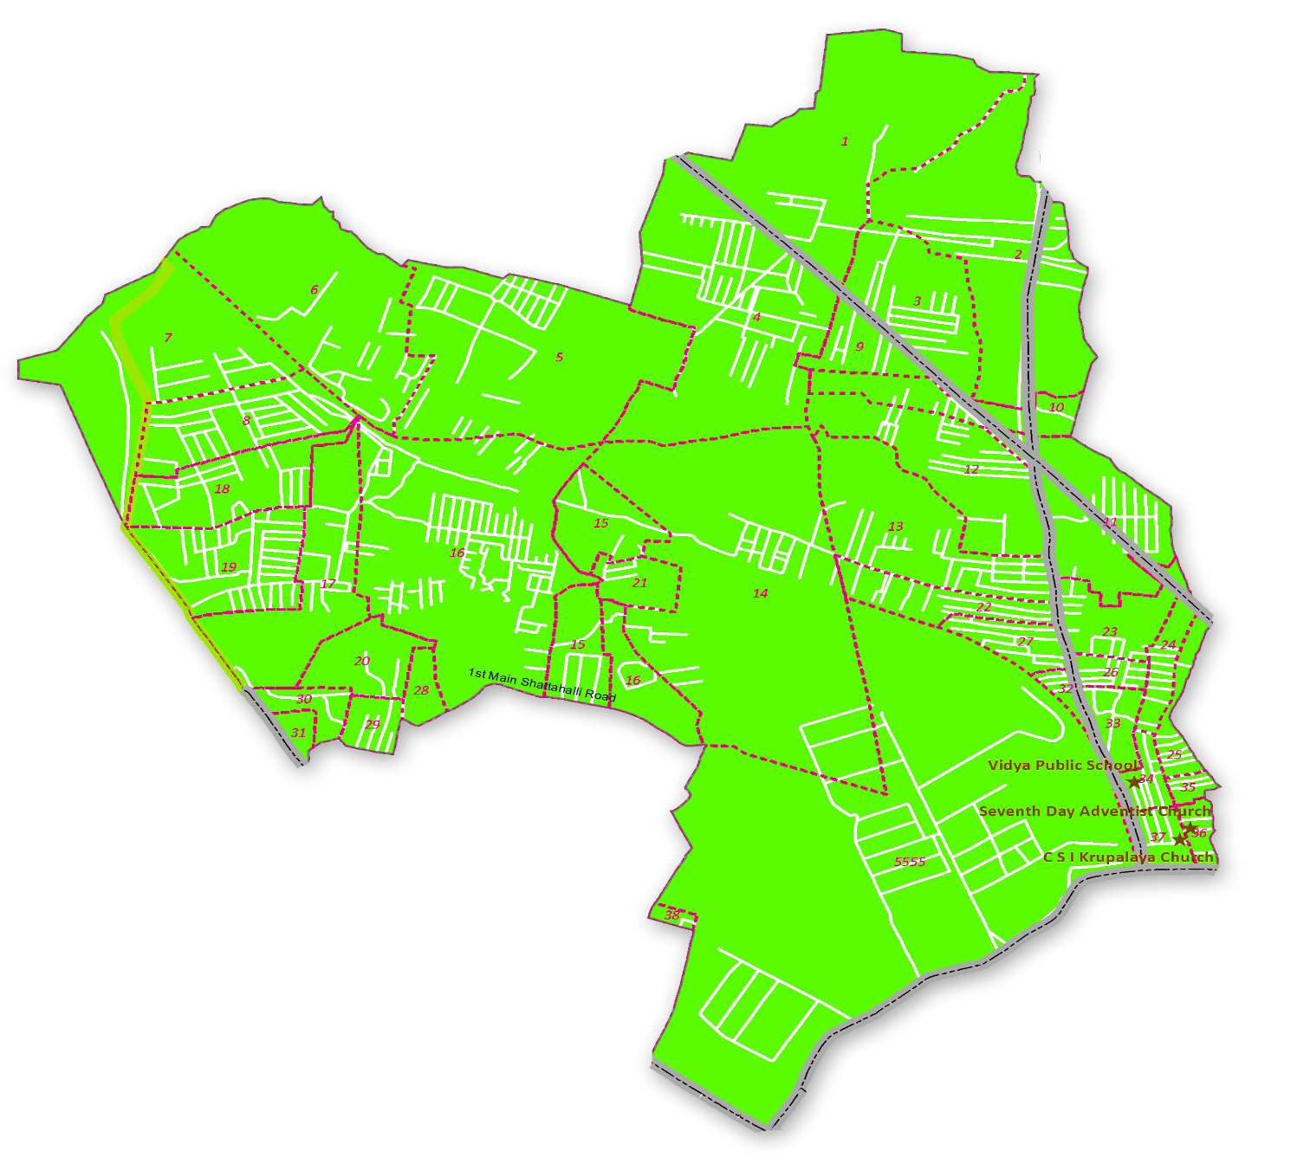
Ward 12 Shettihalli Map
RWAs covered
Paschim County RWA Babanna Layout RWA L V Enclave RWA Sri Siddhi Byraveshwara RWA Vinayaka Layout RWA Jana Snehi Layout RWA

Slide 3
Civic Directory
Agency | Department | Name | Designation | Phone
BBMP | BBMP | K Nagabhushan | Councillor | 9845019093
BBMP | Engineering | Suresh Devathraj | Assistant Engineer | 9448421920
BBMP | Engineering (Major Road) | Nagaraj | Assistant Engineer | 9845106083
BWSSB | BWSSB | Harikumar | Assistant Executive Engineer | 9686448013
BWSSB | BWSSB | Rajeshkar Meti | Assistant Engineer | 7760963670
BBMP | Health | Raghunath T | Health Inspector | 9740480938
BBMP | Horticulture | Chandra Shekar | Superintendent | 9845014293
BBMP | Electrical | Rajendra Nayak | Assistant Executive Engineer | 9480685412
BBMP | Electrical | Babu Reddy | Assistant Engineer | 9343749635
BBMP | Forest | Gopala | RFO | 9480683843
BESCOM | Electrical | Shivananda | Junior Engineer | 9449864539
BCP | Law & Order | Marysayla | Police Inspector | 9480801326
BBMP (SWD) | SWD | Santhosh | Assistant Engineer | 9980037234

Slide 4
MyCityMyBudget Citizen Inputs Status Update

Slide 5
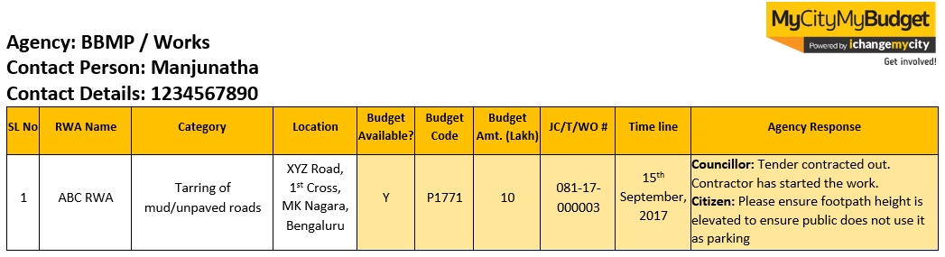
MyCityMyBudget | Guidelines for referring Minutes of Ward Sabha Meeting
The following slides provide a quick snapshot of each of the issues mentioned by RWAs. All agency responses specific to each input are recorded in the slides as well.
All the citizen input slides follow the below table layout:
Agency name and concerned officer details
Serial Number recorded here corresponds to the progress report provided during the ward sabha
This columns record budget availability, budget code, budget amount, job code details are provided by the agency, then data is recorded in these columns. JC- Jobcode, T- Tender, WO- Work Order. and time line.
If the agency provides specific timelines, the information is recorded here
Additional issue-specific comments that were discussed between agency and RWAs are recorded here
These 3 columns record RWA Name, concern (Category) and Address.

Slide 6
Agency : Horticulture / Forest
Contact Person : Chandra Shekar - HS / Gopal - RFO
Contact Details : 9845014293 / 9480683843
SL No | RWA Name | Category | Location | Budget Available? | Budget Code | Budget Amt. (Lakh) | JC/T/WO Status & Number | Time line | Agency Response
1 | Paschim County RWA | Construction of New Bus Shelters | Near Paschim County | - | - | - | - | - | Councillor: Once location will be identified by public and officials, Activity will be taken up
2 | Paschim County RWA | Maintenance of Trees | Paschim County, Medarahalli | - | - | - | - | - | The Agency representative did not attend the meeting
3 | Paschim County RWA | Planting New Trees | 1st, 2nd, 3rd, 4th, 5th, 6th Cross, 1st Main Paschim County, Medarahalli | - | - | - | - | - | The Agency representative did not attend the meeting
4 | Paschim County RWA | Maintenance of Parks | 6th Cross Paschim County, Medarahalli | - | - | - | - | - | Chandra Shekar: This is not under BBMP limits, will crosscheck with the gram panchayat and inform you

Slide 7
Agency : Health / BBMP Electrical
Contact Person : Raghunath T - HI / Rajendra Nayak - AEE
Contact Details : 9740480938 / 9480685412
SL No | RWA Name | Category | Location | Budget Available? | Budget Code | Budget Amt. (Lakh) | JC/T/WO Status & Number | Time line | Agency Response
5 | Paschim County RWA | Fogging and Pest Control | 1st, 2nd, 3rd, 4th, 5th Cross, 1st Main, Paschim County, Medarahalli | Y | - | - | T | 31th Dec 2017 | Ranganath: Fogging in the entire ward is undertaken once a week
6 | L V Enclave RWA | Fogging and Pest Control | 1st, 2nd, 3rd Cross L V enclave | Y | - | - | T | 31th Dec 2017 | Ranganath: Fogging in the entire ward is undertaken once a week
7 | Jana Snehi Layout | Vacant Site Garbage Dumping and Burning | Meddarahalli | - | - | - | - | - | Councillor: Assigned to Health inspector
8 | L V Enclave RWA | Installation of Streetlights | 1st, 2nd, 3rd Cross L V enclave | Y | - | 2 | WO | - | Rajendra Nayak: 15 lakhs budget required but we have only 2 lakhs budget right now, Councillor said that the rest of 13 lakhs will be sought from the council

Slide 8
Agency : BBMP Electrical
Contact Person : Rajendra Nayak - AEE
Contact Details : 9480685412
SL No | RWA Name | Category | Location | Budget Available? | Budget Code | Budget Amt. (Lakh) | JC/T/WO Status & Number | Time line | Agency Response
9 | Babanna Layout RWA | Installation of Streetlights | Babanna Layout | Y | - | 2 | WO | - | Rajendra Nayak: 15 lakhs budget required but we have only 2 lakhs budget right now, Councillor said that the rest of 13 lakhs will be sought from the council
10 | Sri Siddhi Byraveshwara | Installation of Streetlights | Vigneshwara Layout | Y | - | 2 | WO | - | Rajendra Nayak: 15 lakhs budget required but we have only 2 lakhs budget right now, Councillor said that the rest of 13 lakhs will be sought from the council
11 | Paschim County RWA | Repair of Streetlights | 1st and 6th Cross 1st Main, Paschim County, Medarahalli | - | - | - | - | 30th Nov 2017 | Rajendra Nayak: Streetlights problem will be fixed by 30th November

Slide 9
Agency : BBMP Works
Contact Person : Suresh Devathraj
Contact Details : 9448421920
SL No | RWA Name | Category | Location | Budget Available? | Budget Code | Budget Amt. (Lakh) | JC/T/WO Status & Number | Time line | Agency Response
12 | Paschim County RWA | Construction of Playgrounds | Paschim County, Medarahalli | - | - | - | - | - | Councillor: There is no land available for playground but temporarily citizen can use school play ground
13 | L V Enclave RWA | Construction of Road-Side Drains | 1st, 2nd, 3rd Cross L V enclave | Y | - | - | T | 31st Mar 2018 | Councillor: After (Under Ground Drainage) UGD work is completed, we will build box type drain
14 | Babanna Layout RWA | Construction of Road-Side Drains | Babanna Layout New extension | Y | - | - | T | 31st Mar 2018 | Councillor: After (Under Ground Drainage) UGD work is completed, we will build box type drain
15 | Sri Siddhi Byraveshwara | Construction of Road-Side Drains | Vigneshwara Layout | Y | - | - | T | 31st Mar 2018 | Councillor: After (Under Ground Drainage) UGD work is completed, we will build box type drain

Slide 10
Agency : BBMP Works
Contact Person : Suresh Devathraj
Contact Details : 9448421920
SL No | RWA Name | Category | Location | Budget Available? | Budget Code | Budget Amt. (Lakh) | JC/T/WO Status & Number | Time line | Agency Response
16 | Paschim County RWA | Desilting of Existing Road-Side Drains | 1st, 2nd, 3rd, 4th, 5th, 6th Cross, 1st Main, Paschim County, Medarahalli | Y | - | - | T | 31st Mar 2018 | Councillor: Work will start on 31st Mar 2018
17 | Babanna Layout RWA | Desilting of Existing Road-Side Drains | Babanna Layout | Y | - | - | T | 31st Mar 2018 | Councillor: Work will start on 31st Mar 2018
18 | Jana Snehi layout | Desilting of Existing Road-Side Drains | Meddarahalli | Y | - | - | T | 31st Mar 2018 | Councillor: Work will start on 31st Mar 2018
19 | Paschim County RWA | Installation of Covering Slabs for Road-Side Drains | 1st, 2nd, 3rd, 4th, 5th, 6th Cross, 1st Main, Paschim County, Medarahalli | Y | - | - | T | 31st Mar 2018 | Councillor: After (Under Ground Drainage) UGD work is completed, we will build box type drain
20 | Paschim County RWA | Installation of Street Name Boards | 1st, 2nd, 3rd, 4th, 5th, 6th Cross, 1st Main, Paschim County, Medarahalli | Y | - | - | T | 31st Mar 2018 | Councillor: Once location will be identified by public and officials, Activity will be taken up

Slide 11
Agency : BBMP Works
Contact Person : Suresh Devathraj
Contact Details : 9448421920
SL No | RWA Name | Category | Location | Budget Available? | Budget Code | Budget Amt. (Lakh) | JC/T/WO Status & Number | Time line | Agency Response
21 | Jana Snehi Layout | Installation of Street Name Boards | Meddarahalli | - | - | - | T | 31st Mar 2018 | Councillor: Once location will be identified by public and officials, Activity will be taken up
22 | Paschim County RWA | Installation of Surveillance Cameras | 1st Cross, 1st Main Junction, Paschim County | Y | - | - | T | 31st Dec 2017 | Suresh Devathraj: Tender is in process. RWA members to give location for CCTV wherever required we will provide them
23 | Paschim County RWA | Installation of Surveillance Cameras | 3rd Cross End, Paschim County, Medarahalli | Y | - | - | T | 31st Dec 2017 | Suresh Devathraj: Tender is in process. RWA members to give location for CCTV wherever required we will provide them
24 | L V Enclave RWA | Installation of Surveillance Cameras | 1st, 2nd, 3rd Cross L V enclave | Y | - | - | T | 31st Dec 2017 | Suresh Devathraj: Tender is in process. RWA members to give location for CCTV wherever required we will provide them

Slide 12
Agency : BBMP Works
Contact Person : Suresh Devathraj
Contact Details : 9448421920
SL No | RWA Name | Category | Location | Budget Available? | Budget Code | Budget Amt. (Lakh) | JC/T/WO Status & Number | Time line | Agency Response
25 | Paschim County RWA | Lane Marking and Road Signages | 1st, 2nd, 3rd, 4th, 5th, 6th Cross, 1st Main Paschim County, Medarahalli | Y | - | - | T | 31st Mar 2018 | Suresh Devathraj: After the road asphalting complete, we will start lane marking
26 | Paschim County RWA | Tarring of Pothole-Ridden Roads | 5th and 6th Cross, 1st Main, Paschim County, Medarahalli | Y | - | - | WO | 31st Dec 2017 | Councillor: After (Under Ground Drainage) UGD work is completed, we will put concrete
27 | Sri Siddhi Byraveshwara | Tarring of Pothole-Ridden Roads | Vigneshwara Layout | Y | - | - | WO | 31st Dec 2017 | Councillor: After (Under Ground Drainage) UGD work is completed, we will put concrete
28 | Sri Siddhi Byraveshwara | Tarring or Asphalting Of Existing Road | Vigneshwara Layout | Y | - | - | T | 31st Mar 2018 | Councillor: After (Under Ground Drainage) UGD work is completed, we will start Asphalting works

Slide 13
Ward Infrastructure

Slide 14
ವಾರ್ಡ್ # 12 - ಶೆಟ್ಟಿಹಳ್ಳಿ
SCORE for Parks Playground and Public Toilet
The Parks, Playgrounds and Public Toilets 2016 survey was conducted on 1,311 parks & playgrounds and 473 public toilets that fall under BBMP’s purview across Bengaluru. As a part of the survey, the quality of infrastructure and facilities was measured through the use of simple Android Apps. The survey was conducted between October to December 2016. The survey indicator-level information pertinent to your ward.
Name & Address of the Parks | Score
Gelayara Balaga Part-1 | 8
Gelayara Balaga Part-2 | 2
Abbigere Hospital Park | 8
Aaladamara Park | 5
Anjaneya Swamy Temple Park | 7
Vishveshwaraiah Enclave Park | 0
Name & Address of the Playground | Score
Geleyara Balaga Play Ground Shettihalli | 3
Children's Playground Kammagondanahalli | 0

Slide 15
Next Steps
Our recommendations:
Meet after 3 months,
Review status of works
Give inputs into next year’s budget over December & January’
Please register on ichangemycity.com to track ward budgets and civic works

Slide 16
Janaagraha Directory
Manjunath Gowda C M
manjugowda@janaagraha.org
Veerabhadra
veerabhadra@janaagraha.org
9008775001
Janaagraha Centre for Citizenship and Democracy
4th Floor, UNI Building, Thimmaiah Road, Vasanthnagar, Bangalore - 560052
Tel: +91-80-4079-0400 Fax: +91-80-4127-7104
Website: www.janaagraha.org

Slide 17
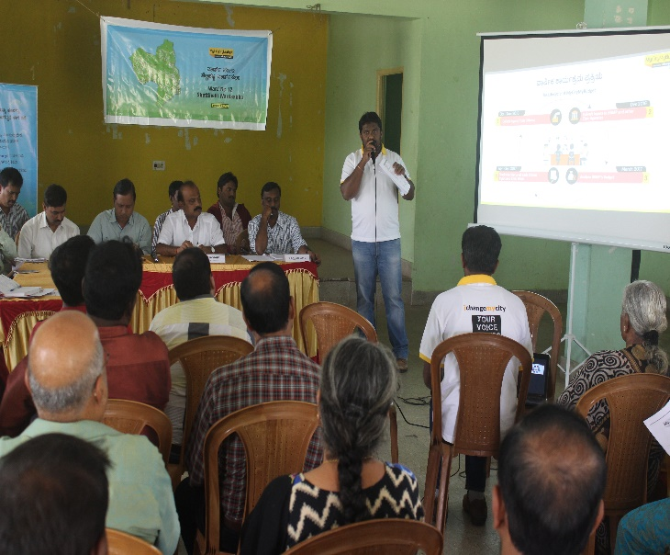
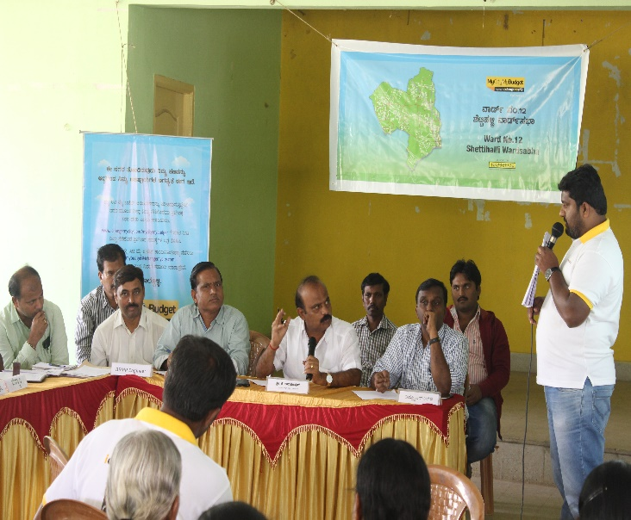
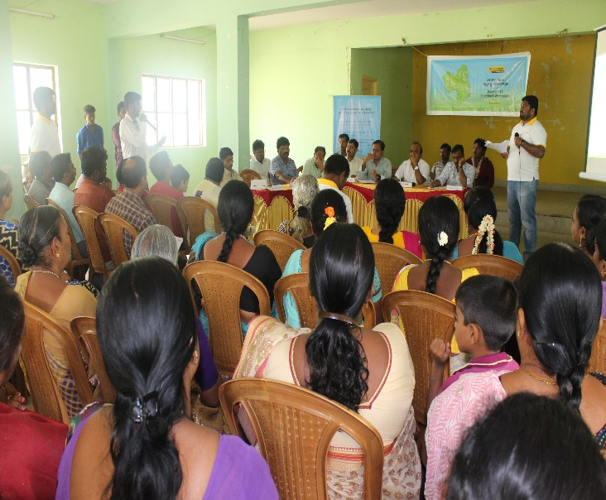
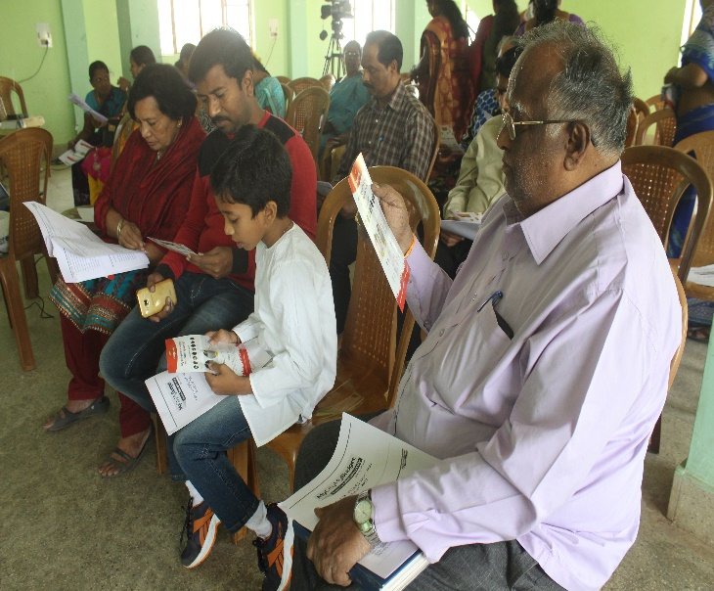
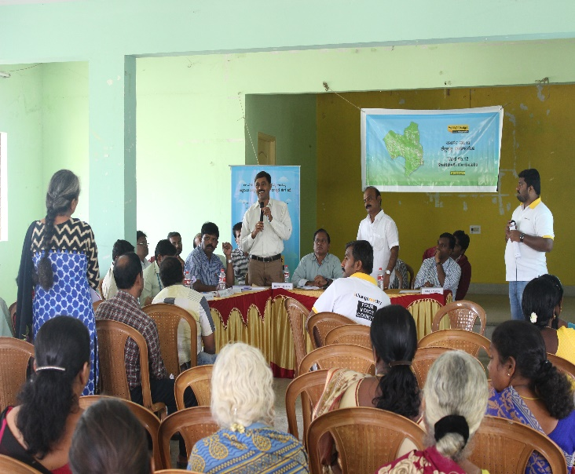
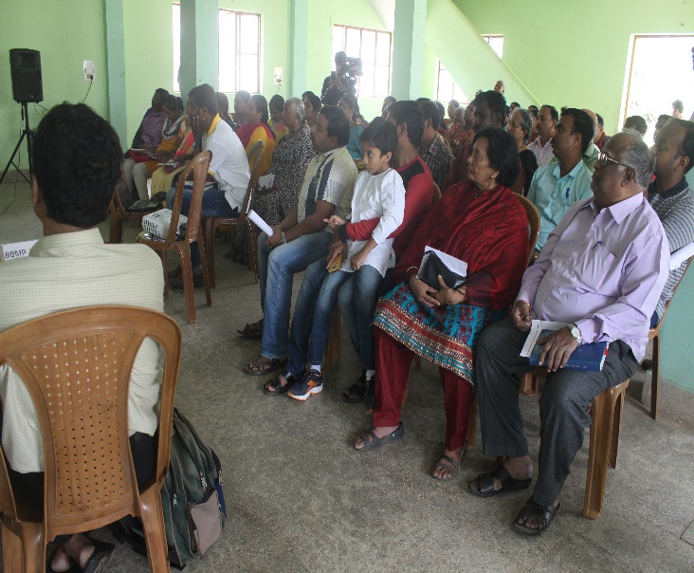
Shettihalli Ward Sabha Photos

