Slide 1

Ward 20 Ganga Nagara | Ward Sabha
28 October 2017

Slide 2

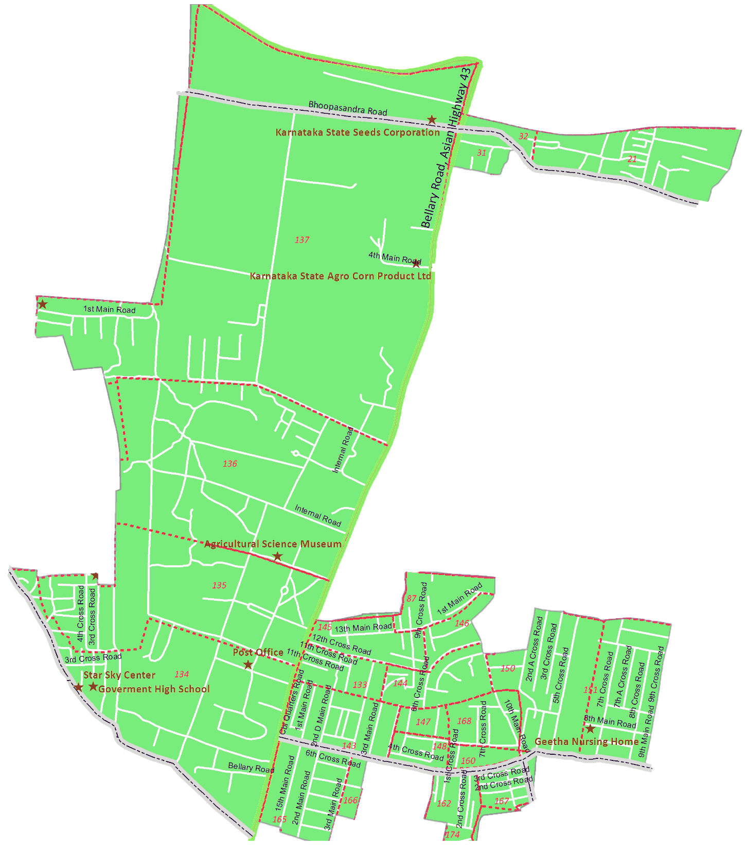
Ward 20 Ganga Nagara Map
RWAs covered
RBI Colony RWA Vishveshwaraiah Nagar RWA Ananda Jyothi RWA
Ananda Jyothi RWA
RBI Colony RWA
Vishveshwaraiah Nagar RWA

Slide 3
Civic Directory
Agency | Department | Name | Designation | Phone | Email
BBMP | BBMP | Prameela M Anand | Councillor | 9620888077
BBMP | Engineering | Srinivas Murthy | Assistant Engineer | 9448043480
BBMP | Health | Srinivas | Health Inspector | 7411724554
BBMP | Horticulture | Manjula | Horticulture Inspector | 9845058004
BBMP | Electrical(Streetlight) | Anand | Junior Engineer | 8277667936
BBMP | Forest | Shantha Kumar | ACF | 9480683146
BBMP | Major roads | Puttaswamy A | Assistant Engineer | 9481078509
BBMP | SWD | Basavarajappa S T | Assistant Executive Engineer | 9448154988
BESCOM | Electrical | Nagaraj | Assistant Engineer | 9449864894
BWSSB | Engineering | Channabasaviah | Assistant Executive Engineer | 9845444025
BCP | Law and order | Ajay Sarathi | Police Inspector | 9480801330
BTP | Traffic | Firoz Khan | Police Inspector | 9448182924

Slide 4
MyCityMyBudget Citizen Inputs Status Update

Slide 5
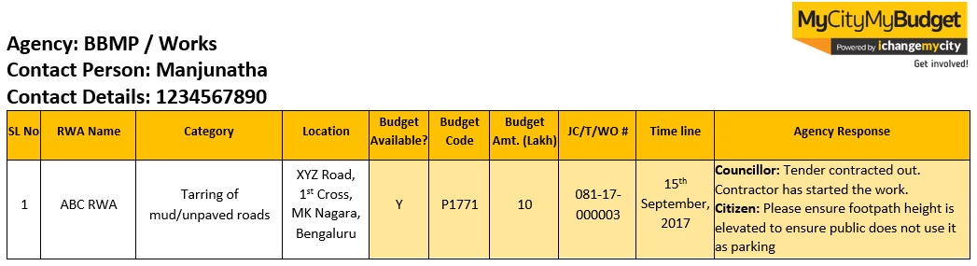
MyCityMyBudget | Guidelines for referring Minutes of Ward Sabha Meeting
The following slides provide a quick snapshot of each of the issues mentioned by RWAs. All agency responses specific to each input are recorded in the slides as well.
All the citizen input slides follow the below table layout:
Agency name and concerned officer details
Serial Number recorded here corresponds to the progress report provided during the ward sabha
This columns record budget availability, budget code, budget amount, job code details are provided by the agency, then data is recorded in these columns. JC- Jobcode, T- Tender, WO- Work Order. and time line.
If the agency provides specific timelines, the information is recorded here
Additional issue-specific comments that were discussed between agency and RWAs are recorded here
These 3 columns record RWA Name, concern (Category) and Address.

Slide 6
Agency : BBMP – Works
Contact Person : Srinivas Murthy - AE
Contact Details : 9448043480
SL No | RWA Name | Category | Location | Budget Available? | Budget Code | Budget Amt. (Lakh) | JC/T/WO Status & Number | Time line | Agency Response
1 | RBI Colony RWA | Desilting of Existing Road-Side Drains | RBI Colony, Entire Area Gaganagara | Y | P 1771 | - | - | - | Srinivas Murthy: This work is budgeted this year and will be take up once the work estimate is approved
2 | RBI Colony RWA | Tarring of Roads | From RBI colony to M K Amid Shopping Centre, Ganganagara | Y | - | - | - | - | Srinivas Murthy: Work Completed.
3 | Vishveshwaraiah Nagara RWA | Build composting units | C A Site No 10 Behind MK Ahmed Shop HMT Layout, Vishveshwaraiah Nagara | Y | - | 30 | W | - | Srinivas Murthy: Budgets available for this work in 2017-18. Feedback from Citizens around the CA site will be taken prior to proceeding.
4 | Vishveshwaraiah Nagara RWA | Installation of Covering Slabs for Road-Side Drains | 1st Cross to 8th Cross, HMT Layout | Y | - | 14 | T | 28th Feb 2018 | Srinivas Murthy: Tender in process.

Slide 7
Agency : BBMP – Works/ Major Roads
Contact Person : Srinivas Murthy – AE / Puttaswamy A-AE
Contact Details : 9448043480 / 9481078509
SL No | RWA Name | Category | Location | Budget Available? | Budget Code | Budget Amt. (Lakh) | JC/T/WO Status & Number | Time line | Agency Response
5 | Vishveshwaraiah Nagara RWA | Tarring of Roads | 6th to 7th Main Vishveshwaraiah Nagara, Ganga Nagara | Y | - | - | T | - | Srinivas Murthy: This work is budgeted this year and will be take up once the work estimate is approved
6 | Ananda Jyothi RWA | Construction of Park | C A Site No 10 Behind MK Ahmed Shop HMT Layout, Vishveshwaraiah Nagara | Y | - | 30 | W | - | Srinivas Murthy: This work is budgeted this year and will be take up once the work estimate is approved
7 | Ananda jyothi RWA | Construction of Road-Side Drains | 7th Cross Pillappa block Ganganagar | Y | - | - | W | - | Srinivas Murthy: Problem to be solved after spot inspection
8 | Vishveshwaraiah Nagara RWA | Lane Marking and Road Signages | CBI Road, 80Feet Road, HMT Layout, Hebbal | - | - | - | - | - | Puttaswamy A: The Agency representative did not attend the meeting
9 | Vishveshwaraiah Nagara RWA | Repair of Existing Footpaths | CBI Road and 80 Feet Road, Hebbal | - | - | - | - | - | Puttaswamy A: The Agency representative did not attend the meeting

Slide 8
Agency : BBMP – Forest / Health
Contact Person : Shantha Kumar - ACF / Srinivas-Health Inspector
Contact Details : 9480683146 / 7411724554
SL No | RWA Name | Category | Location | Budget Available? | Budget Code | Budget Amt. (Lakh) | JC/T/WO Status & Number | Time line | Agency Response
10 | RBI Colony RWA | Maintenance of Trees | RBI Colony 1st Main Road and Link Road | - | - | - | - | - | Shantha Kumar: The Agency representative did not attend the meeting.
11 | Vishveshwaraiah Nagara RWA | Planting New Saplings | 6th B Main Vishveshwaraiah Nagar, Ganga Nagara | - | - | - | - | - | Councillor: Already entire ward we are planting saplings, If you required please use BBMP green app.
12 | RBI Colony RWA | Fogging and Pest Control | RBI Colony, Ganga Nagara | - | - | - | - | - | Srinivas: The Agency representative did not attend the meeting.
13 | Ananda jyothi RWA | Fogging and Pest Control | 7th Cross Pillappa block, Ganga Nagara | - | - | - | - | - | Srinivas: The Agency representative did not attend the meeting.

Slide 9
Agency : BBMP – Horticulture / SWD / Electrical
Contact Person : Manjula - HI / Basavarajappa S T- AEE / Ananda - JE
Contact Details : 9845058004 / 9448154988 / 8277667936
SL No | RWA Name | Category | Location | Budget Available? | Budget Code | Budget Amt. (Lakh) | JC/T/WO Status & Number | Time line | Agency Response
14 | RBI Colony RWA | Maintenance of Community Halls in Side the Park | RBI Colony, Punjab Nation Bank Behind Ganga Nagar | Y | - | - | W | 30th, October 2017 | Manjula: Work will be start
15 | RBI Colony RWA | Maintenance of Parks | BBMP Park Behind Punjab National Bank Anandnagar Hebbal | - | - | - | - | - | Manjula: Work under progress
16 | RBI Colony RWA | Desilting of Storm Water Drains | RBI Colony Vasanthappa Block Ganga Nagar | - | - | - | - | - | Councillor: Work under progress
17 | Vishveshwaraiah Nagara RWA | Installation of Streetlights | 80 Feet Road, HMT Layout, R T Nagara | Y | - | - | - | - | Anand: Already Street light installed and Automatic timer need to install

Slide 10
Ward Infrastructure

Slide 11
Ward # 20- Ganga Nagara
SCORE for Parks Playground and Public Toilet
The Parks, Playgrounds and Public Toilets 2016 survey was conducted on 1,311 parks & playgrounds and 473 public toilets that fall under BBMP’s purview across Bengaluru. As a part of the survey, the quality of infrastructure and facilities was measured through the use of simple Android Apps. The survey was conducted between October to December 2016. The survey indicator-level information pertinent to your ward.
Name & Address of the Parks | Score
Veternary Hospital Opp Park Ganganagara | 5
Ganganagra Viewers Colony | 5
Veternary College Compound Park Part 2 | 7
Aluminum Association Opp Park | 8
1st main road, word offices | 9
Sri Siddi Vinayaka Badavane 1st main road | 0
Sri Siddi Vinayaka Badavane Park | 0
Lakshmaiah Park | 0

Slide 12
Ward # 20- Ganga Nagara
SCORE for Playground and Public Toilet
Name & Address of the Playground | Score
Ganga Nagara, HMT Layout, BBMP Playground | 3
5th Main Road, KEB Layout | 3
HMT Layout, Opp Presidency School | 3
Lakshmaiah Play Ground, Ganga Nagara | 5
Address of the Public Toilet | Score
Near HMT Play Ground | 4.5
5th Main Road, Ganga Nagara | 4.5

Slide 13
Next Steps
Our recommendations:
Meet after 3 months,
Review status of works
Give inputs into next year’s budget over December & January’
Please register on ichangemycity.com to track ward budgets and civic works

Slide 14
Janaagraha Directory
Manjunatha H L
manjunath@janaagraha.org
Veerabhadra
veerabhadra@janaagraha.org
9008775001
Janaagraha Centre for Citizenship and Democracy
4th Floor, UNI Building, Thimmaiah Road, Vasanthnagar, Bangalore - 560052
Tel: +91-80-4079-0400 Fax: +91-80-4127-7104
Website: www.janaagraha.org

Slide 15
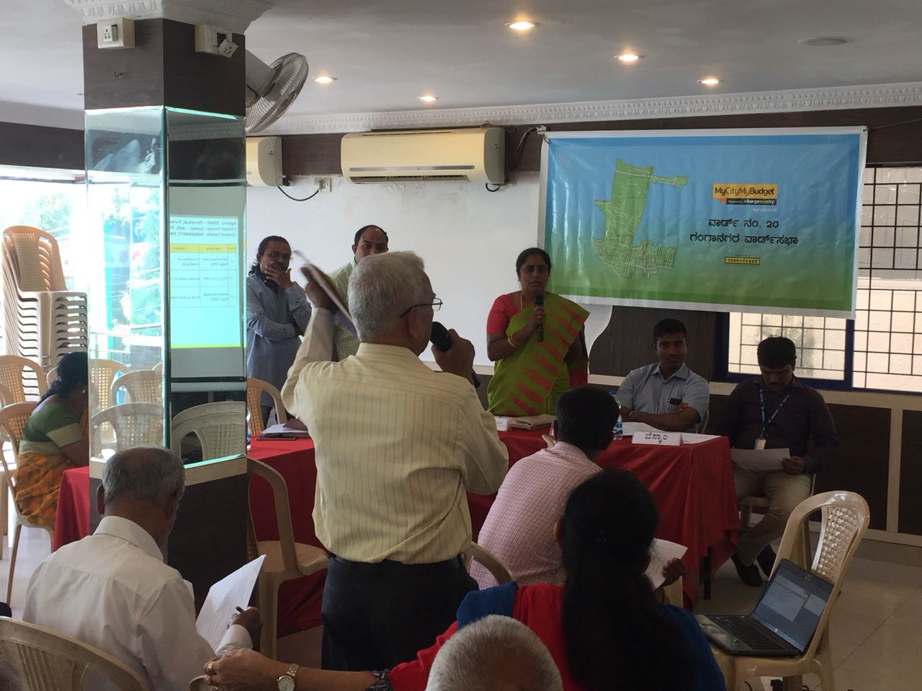
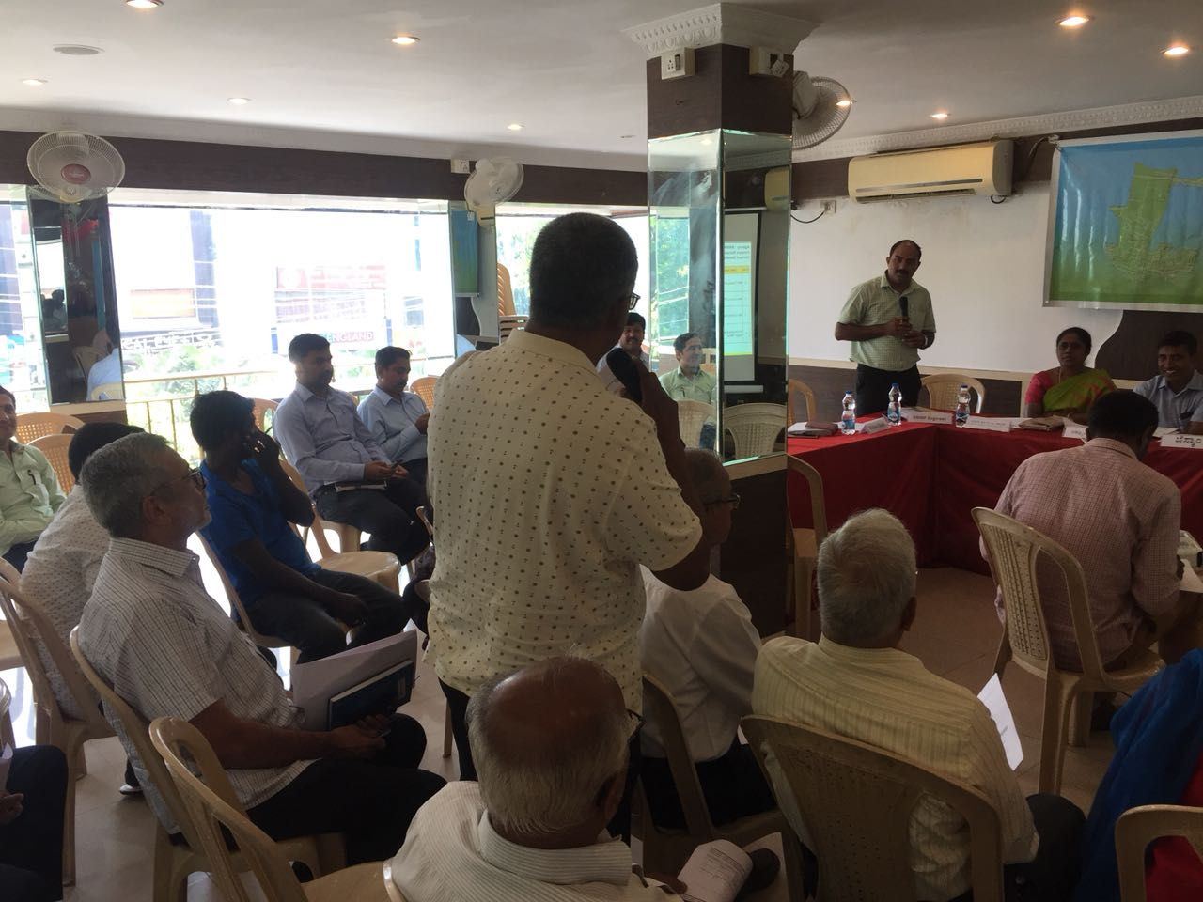
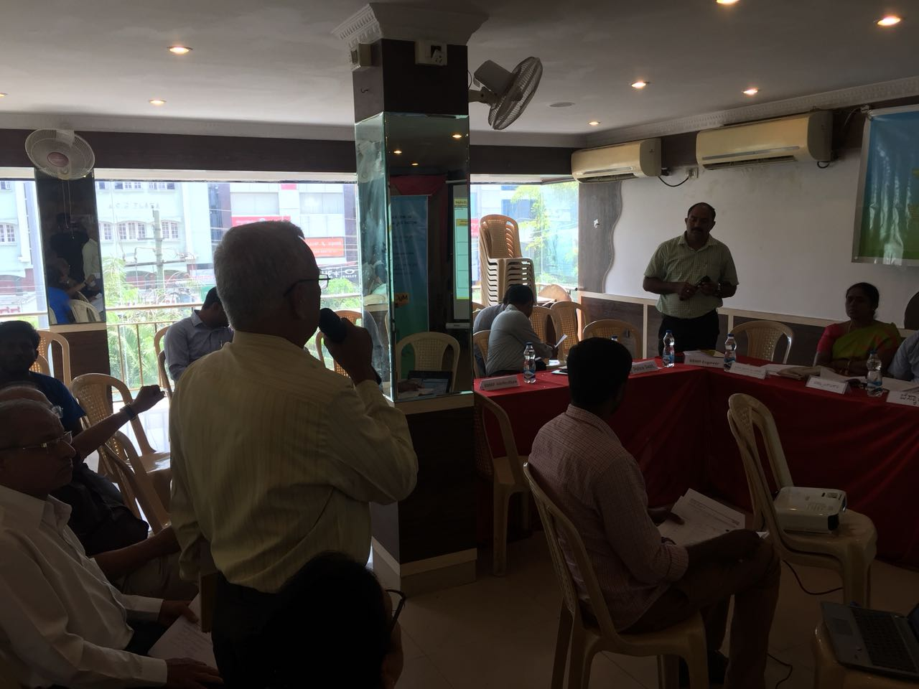
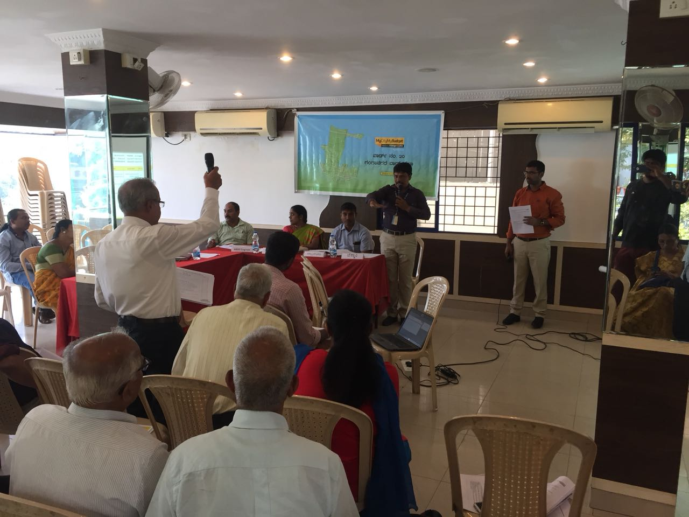
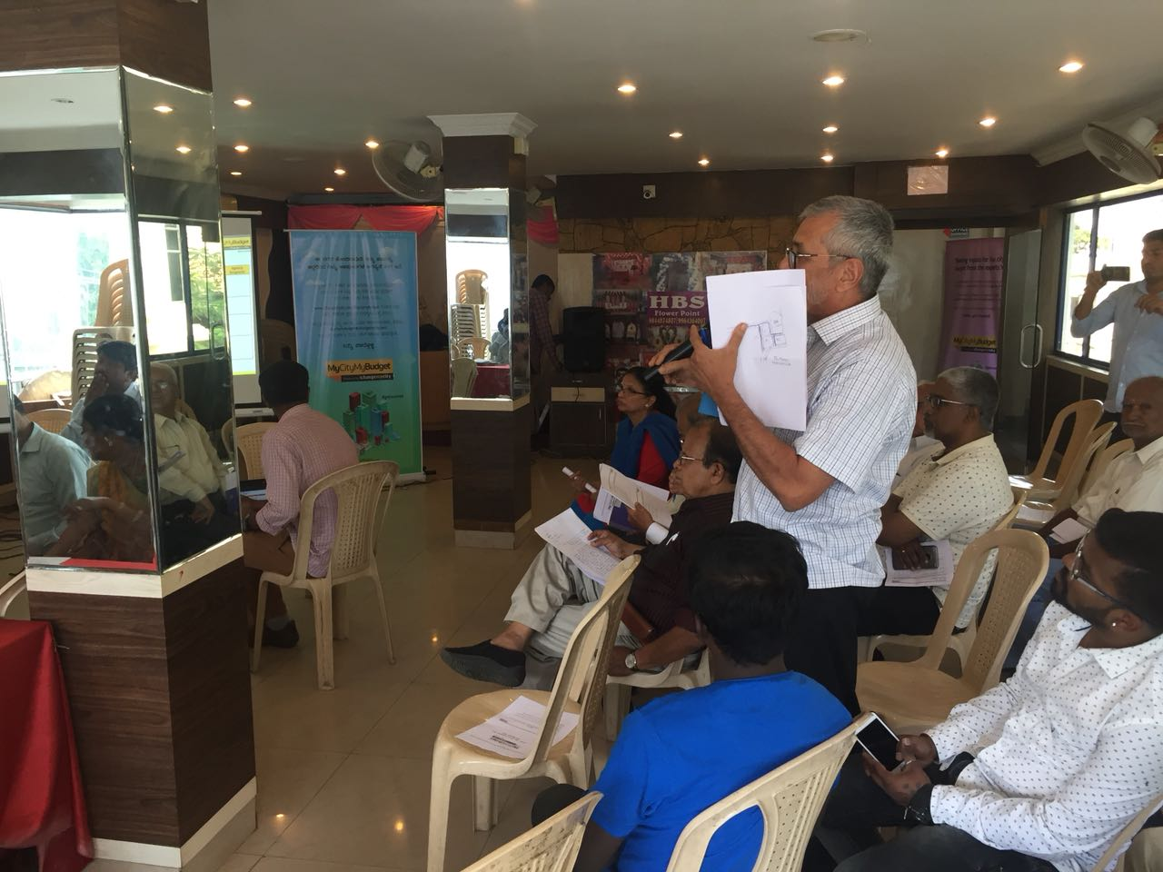
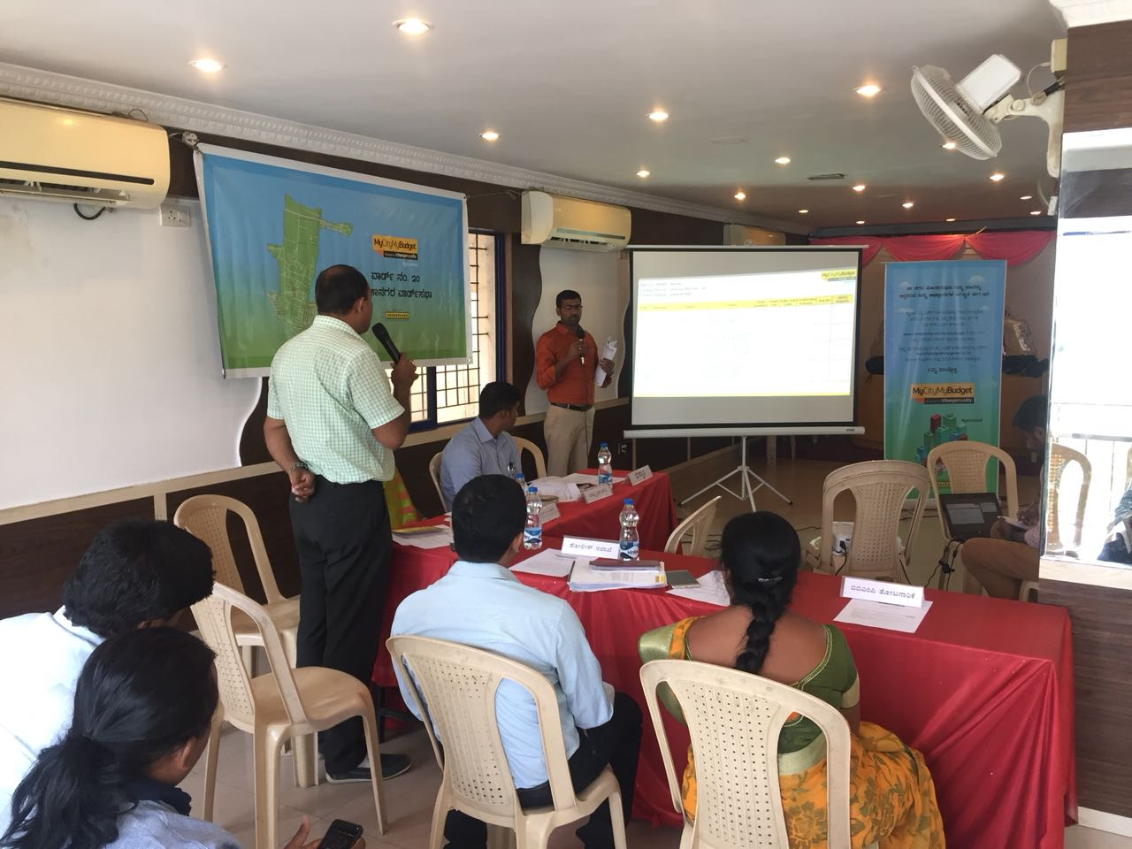
Ganga Nagara Ward Sabha Photos

